Slide 1
Soft but not Squishy: Enhancing Social Realism in Computer Science Education
Andrew Begel
Microsoft Research, Redmond, USA

Slide 2
User-centered tool design
We study software development
recording current practice
observing in the lab & in the field
evaluating tool solutions
We create new tools
based on what we observe
releasing within Microsoft
influencing Microsoft products

Slide 3
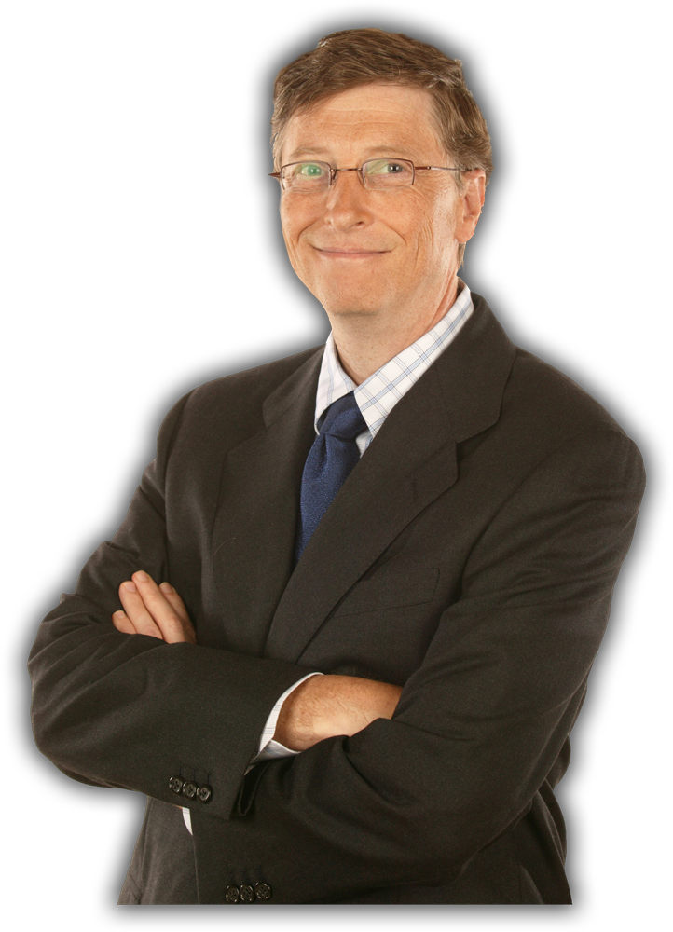


James
Bill
  Background
  Programmed in Basic on his Mac in
  elementary school.
  Dad is a software engineer.
  Was into math, web programming in high school
  Computer Science major, Bachelors degree
  Educated in coastal USA
  Favorite class: Cryptography
  Participated in contests to break ciphers
  Languages: C, C++, Java, Javascript,
  Python
  Learned ASP, COM, Win32

Slide 4
James Joins Microsoft
Meets manager – meets team
Has no mentor – sets up computer, toolchain by himself
Gets first task from Developer Lead
First assignment
  Take over two bugs from another dev who is out
  Debug some code owned by another team

Slide 5
James Fixes a Bug
While reading through the code, spots a funny-looking line of code.
Decides it’s wrong, fixes the code.
The rules say to file a bug report, so he does.
At bug triage meeting the next day, he volunteers for the bug.
At his desk, he checks in his fix and marks the bug closed.
His “fix” breaks the build, and he must revert.

Slide 6
What did James do wrong?
James did not follow team’s procedure for finding and triaging bugs.
The code is MUCH bigger and more tightly integrated than James realized.
James did not ask anyone to check his fix before deciding it was right.
The code in question actually did not need to be fixed.
James wanted to impress his team with a non-essential bug fix.

Slide 7
Three Beliefs about Starting a Job in Software Engineering
I have to be perfect, or else I’ll get fired.
It can’t be the documentation, it must be me.
If it compiles, I’m done.
If it doesn’t work, I will try every possible thing I can to make it work,
even if it is unlikely I will succeed.

Slide 8
Technical Education vs.
Social Education
Computer Science Curricular Organization
  Hard skills – programming, debugging, design
  Soft skills – specifications, documentation, development methodology, teamwork
Newcomer Socialization – Organizational Behavior
  Function, Hierarchy, Social Network
  Evaluation Metrics
    Stress, Anxiety, Role Clarity, Role Orientation, Job Satisfaction, Person-Group Fit, Person-Organization Fit, Intention to Quit

Slide 9
What New Developers Do
Programming | Reading, Writing, Commenting, Proof-reading, Code Review
Working on Bugs | Reproduction, Reporting, Triage, Debugging
Testing | Reading, Writing, Running
Project Management | Check in, Check out, Revert
Documentation | Reading, Writing, Search
Specifications | Reading, Writing
Tools | Discovering, Finding, Installing, Using, Building
Communication | Asking Questions, Persuasion, Coordination, Email, Meetings, Meeting Prep, Finding People, Interacting with Managers, Teaching, Learning, Mentoring

Slide 10
New Developers Communicate
Programming | Reading, Writing, Commenting, Proof-reading, Code Review
Working on Bugs | Reproduction, Reporting, Triage, Debugging
Testing | Reading, Writing, Running
Project Management | Check in, Check out, Revert
Documentation | Reading, Writing, Search
Specifications | Reading, Writing
Tools | Discovering, Finding, Installing, Using, Building
Communication | Asking Questions, Persuasion, Coordination, Email, Meetings, Meeting Prep, Finding People, Interacting with Managers, Teaching, Learning, Mentoring

Slide 11
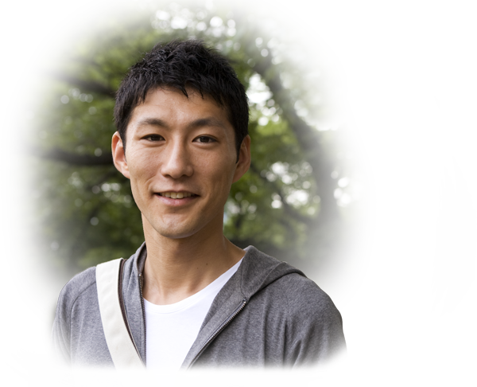
Xin
Background
Played games on computers since junior high.
Programmed a little in high school.
Education
Computer Science major, Bachelors, Ph.D.
Educated in China and USA.
Learned technology useful for
research in college and university
Worked on multimedia codecs
for his Ph.D.

Slide 12
Xin Joins Microsoft
Joins team – meets manager
Group reorganized – no more manager
Xin gets manager after a few weeks
First task – fix a bug

Slide 13
It must be me
Follows bug reproduction steps, but cannot reproduce the bug
Tries a new machine, new OS, debug/release binaries, 32/64-bit code, new binaries from a file share. Nothing works.
After 45 minutes, asks guy across hall for help, but doesn’t get good advice.
After 40 minutes, asks guy again, but again, doesn’t get good advice.
After 20 minutes, makes guy come over to his office, where he finds out he has the wrong understanding of the system, and he screwed something up 1.5 hours ago.

Slide 14
What did Xin learn?
Just because someone with more experience than you wrote it down, it isn’t necessarily correct.
Persistence without reflection = STUCK
When asking a question, make sure you explain enough to get the answer you want.
Live in-person helps always beats documentation.

Slide 15
Fixing a Bug (University)
Reproduce the bug in the runtime,
Isolate the bug in a debugger,
Read the source code for the program,
Fix the bug by programming workaround code,
Test the fix,
Check in the fix into source control.

Slide 16
Fixing a Bug (Industry)
Read the bug report,
Reproduce the bug in the runtime,
Isolate the bug in a debugger,
Read the source code for the program,
Ask questions of co-workers to understand the source code and the root cause of the bug,
Fix the bug by programming several different code workarounds,
Test the fixes,
Get the fixes reviewed by a manager or co-worker,
Attend a bug triage meeting to report on the status of the bug,
Convince co-workers that one of the fixes is the right one under the circumstances,
Figure out if a new regression test should be written,
Work with a tester to verify that the chosen fix did not cause any further regressions,
Attend another bug triage meeting to report on the status of the bug,
Meet with managers of other components that may be affected by the bug fix and persuade them to sign off on it,
Check in the fix into source control,
Finally, write up the results of the investigation and bug fix in the bug report.

Slide 17
Fixing a Bug (Industry)
Read the bug report,
Reproduce the bug in the runtime,
Isolate the bug in a debugger,
Read the source code for the program,
Ask questions of co-workers to understand the source code and the root cause of the bug,
Fix the bug by programming several different code workarounds,
Test the fixes,
Get the fixes reviewed by a manager or co-worker,
Attend a bug triage meeting to report on the status of the bug,
Convince co-workers that one of the fixes is the right one under the circumstances,
Figure out if a new regression test should be written,
Work with a tester to verify that the chosen fix did not cause any further regressions,
Attend another bug triage meeting to report on the status of the bug,
Meet with managers of other components that may be affected by the bug fix and persuade them to sign off on it,
Check in the fix into source control,
Finally, write up the results of the investigation and bug fix in the bug report.

Slide 18
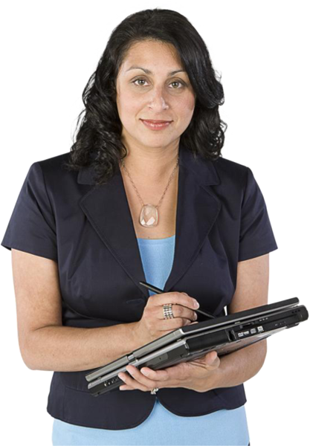
Esperanza
  Background
  Worked with computers in primary school
  Usually created software by herself
  Computer options at school were too much about playing
  Decided on software engineering in high school
  Education
  Computer Science major, Bachelors degree
  Educated in Mexico
  Favorite classes: Compilers, AI, Graphics
  Languages: Java, C and C++
  Worked with Microsoft and FOSS toolsets
  Had coding projects, but never wrote tests

Slide 19
Esperanza Joins Microsoft
Meets manager – meets team
Meets mentor, who helps her set up computer, toolchain
Gets first task
  Port software from 32-bit to 64-bit
  First assignment: Fix 200 out of 1300 compiler warnings

Slide 20
Automation is the Solution
Many of the compiler warnings are similar
Write a Perl script to fix 60 warnings at a shot!
  Check out code
  Execute perl script to regexp replace code
  Use WinDiff to check 2-3 files to see if replacement looks good
    If not, revert changes that WinDiff reported, edit Perl script regexp, go back to #1
  Compile whole program
    If # of errors went down, we’re done!

Slide 21
What did Esperanza Do Wrong?
No testing of her own.
Not methodical about verifying results.
Overreliance on others to find her mistakes.
  Ad hoc absorption of MS developer culture.
No awareness of helpful tools.
Too eager to impress others with her speed.

Slide 22
Newcomer Realizations about Starting a Job in Software Development

Slide 23
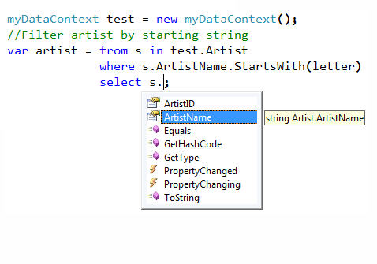
1. Source code may be the ultimate source of truth…

Slide 24
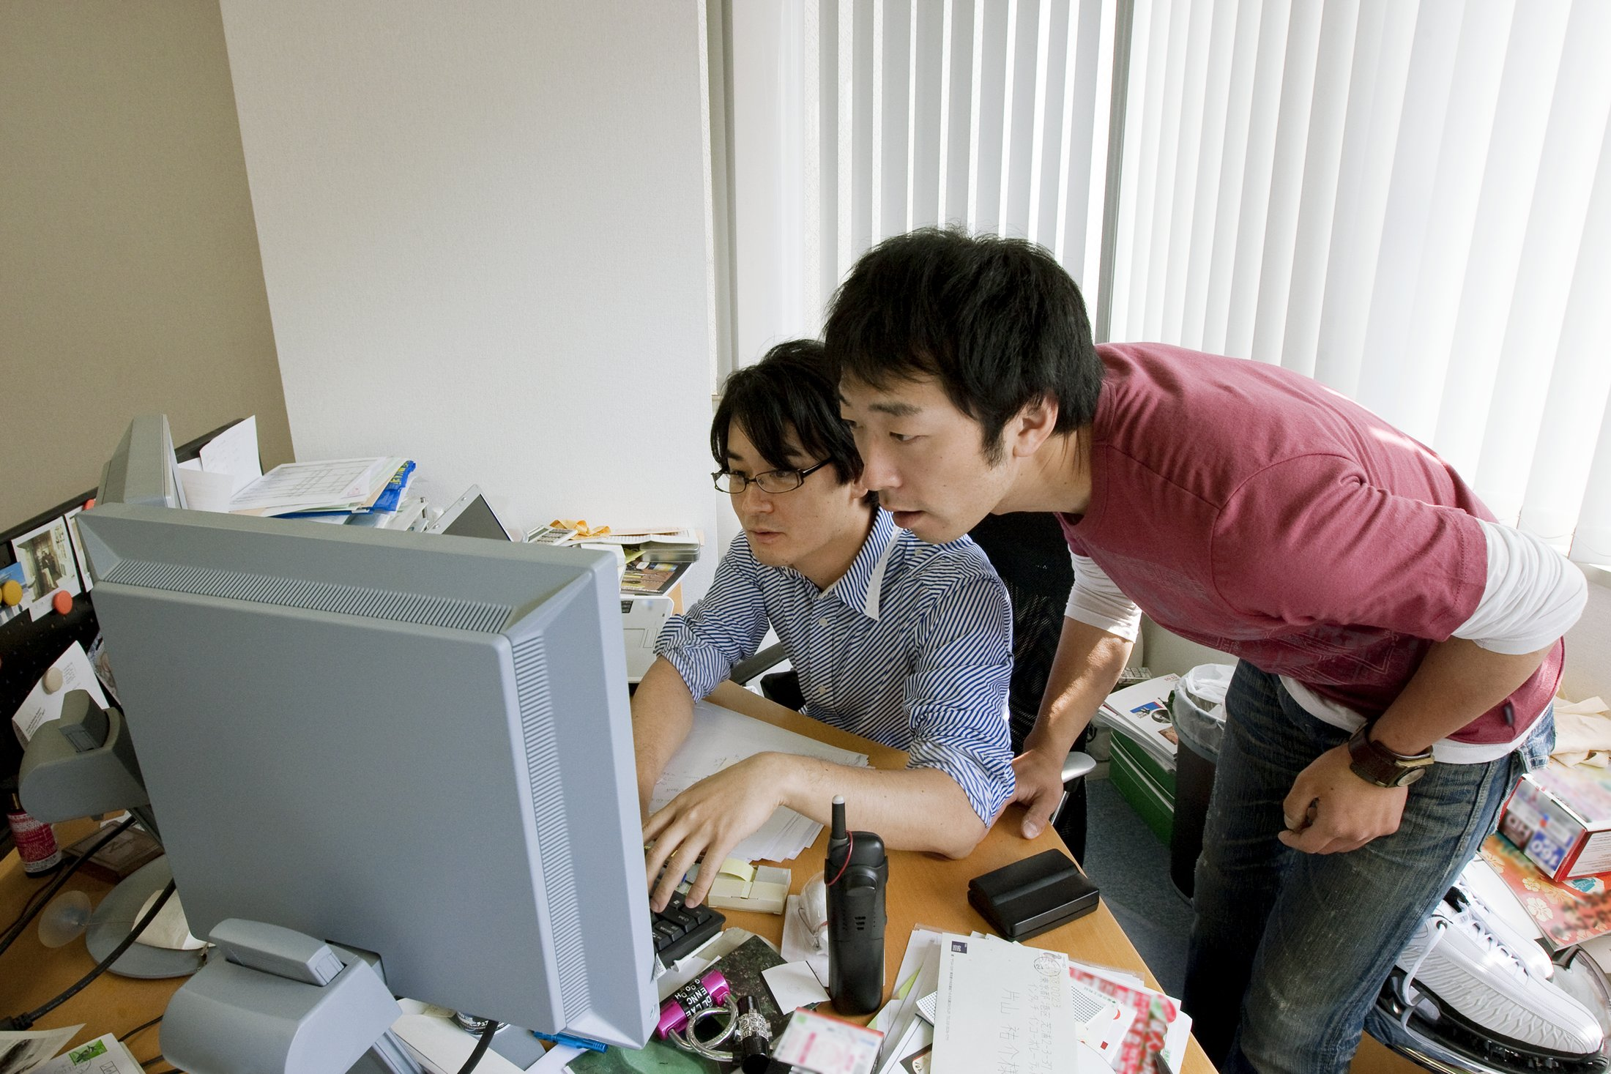
…but the best way to learn the truth is from others.
“You can figure out something in five minutes by asking someone instead of spending a day of looking through code and design docs.”

Slide 25

2. When in Rome…
“When I first got here, I would compose a verbose email with the problem, possible solutions, and my recommendations, [but] most people weren't reading the whole email. Now [my] emails are shorter. If it's going to take more than a paragraph, I probably need to do it in person.”

Slide 26

3. Social interactions are the key
“What I think I need to improve on is being a team player… When my teammates have a success, or when they need help, I want to be more willing to make their goals my goals as well. Because their success is the success of the team and I want to help the team to be successful.”

Slide 27

We can make it better.
First, study what is going on.

Slide 28
Lethbridge Survey, CSEET 1998
What do professional software engineers think was important in their CS Education?
  Programming Languages
  Data Structures
  Software Design
  Software Architecture
  Requirements Gathering

Slide 29
Lethbridge Survey, CSEET 1998
What was missing from their CS Education that they needed and would have liked?
  Negotiation
  Human-Computer Interaction
  Leadership
  Real-time Systems
  Management

Slide 30

Increase social realism in the curriculum.

Slide 31
A Multitude of Opportunties
Communication Skills
Social Simulation
Peer Mentoring
Pair Programming
Brownfield Software Engineering
Community-based Service
Global Distributed Software Development
Legitimate Peripheral Participation
Competition
Microsoft Partnership
Notes:
NSF CPATH Project – Incorporating Communication Skills Throughout the Computer Science and Software Engineering Curricula – Miami University of Ohio, NCSU (participants from Eastern Michigan U, MIT, U Minnesota, Chalmers U of Tech, Sweden, U Guelph, Ontario, Clemson U, Tenn Tech U, U Central Floria, Quinnipiac U, Muhlenberg College, Rose-Hulman, Michigan Tech Institute,

Slide 32
Teach Communication Skills
“Incorporating Communication Skills Throughout the Computer Science and Software Engineering Curricula”
Augment CS curricula with explicitly designed communications learning goals, instruction, assignments, and evaluation.
  NSF CPATH II Project
  Leads: Miami University of Ohio, NCSU
  Participants from 14 institutions
  From Computer Science and Communications
http://cpath.csi.muohio.edu
For more information, come to our panel!
Today, 3:30pm-5pm, Honolulu 3

Slide 33
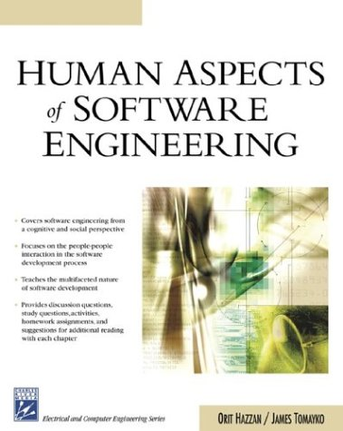
Social Simulation

Slide 34

Support Peer Mentoring

Slide 35
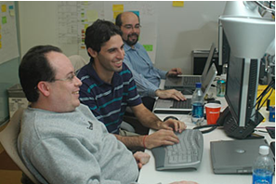
Practice Pair Programming

Slide 36

Try Brownfield Software Engineering

Slide 37

Community-Based Service Projects
Notes:
Engineers without Borders
"Using Community-Based Service Projects to Enhance Undergraduate HCI
Education: 10 years of Experience" from Jonathan Lazar at Towson U.

Slide 38
Global Distributed Software Development
“Internationalization of CS Education”
Provides awareness of culture and needs of international communities; exposes students to issues related to distributed development.
  NSF CPATH Project
  Leads: U Oregon, Portland State U, Willamette U
  Participants from 13 US & 16 Asian universities
http://www.CPATHi18n.org

Slide 39

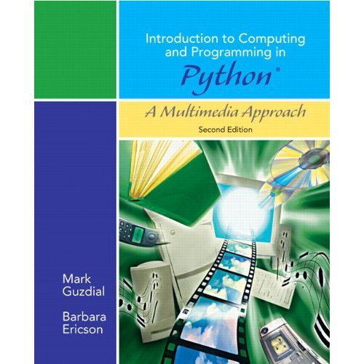
(Il)legitimate Peripheral Participation

Slide 40



Enter Competitions
Imagine Cup for secondary and university age students
Kodu Cup for kids ages 9-17
  Imagine Cup Categories
  Software Design
  Embedded Dev
  Game Design
  Digital Media
  Win Phone 7
  Interoperability Challenge
  IT Challenge
  Orchard Challenge
  Windows 7 Touch Challenge
http://www.ImagineCup.com
http://KoduCup.us

Slide 41
Partnerships with Microsoft
Local sponsorship of capstone courses
  Imagine Cup Mobile Voting application created by one team from Seattle University
Technology facilitation
  Project Hawaii: Cloud services for Mobile Computing (30 universities world wide)
  Kinect SDK
Shepherd nascent research communities
  eScience, video games, cloud futures
Notes:
Cloud services
Relay
Rendezvous
Speech to Text
OCR in the cloud
Compute in Windows Azure
Storage in Windows Azure
Development Environment (SDKs)
Windows Phone 7

Slide 42
Microsoft Software Engineering Innovation Foundation 2010 (SEIF)
Name | Title | Institution
Diego Garbervetsky | Resource Usage Contracts for .NET | Universidad de Buenos Aires, Argentina
Sebastian Uchitel | Strengthening Code Contracts with Typestates | Universidad de Buenos Aires, Argentina
Karin Breitman | Cloud‐Based Software Engineering: Weaving Elasticity into Early Design | PUC do Rio de Janeiro, Brazil
Gail Murphy | Automatically Finding Help for Framework Usage | University of British Columbia, Vancouver, Canada
Sunghun Kim and Jim Whitehead | Detecting and Fixing Bugs as they are Created in Visual Studio | The Hong Kong University of Science and Technology, China
Pankaj Jalote | An Integrated Approach for Software Engineering Projects using Visual Studio Platform | IIIT-Delhi, India
Stefano Tonetta | Formal Methods for Embedded Systems Requirements | Povo-Trento, Italy
Baris Aktemur | A Type System with Subtyping for Program Generation Using Quasiquotations | Ozyegin University Istanbul, Turkey
Daniel Kroening | Testing Embedded Software with the Z3 SMT Solver | Oxford University, United Kingdom
Kendra Cooper | SimSys: An Engaging Game for Software Engineering Education | The University of Texas at Dallas, United States
David Notkin and Michael Ernst | Speculation and Continuous Validation for Software Development | University of Washington, Seattle, United States
Alessandro Orso | BERT – BEhavioral Regression Testing | Georgia Institute of Technology, Atlanta, United States
Come see 4 SEIF recipients talk
about their projects!
Friday 5:45pm, South Pacific 4

Slide 43
Whatever Happened to…
James
  Has better email writing skills: “what to say, when to not send a mail.” At the beginning, he was “more scared to write.” He now understands “what people expect when they write ‘I want this’ and it doesn't align with your priorities or what you're doing.” Knows “how to answer in the right way.”
Esperanza
  “Understandability is more important than making the fastest or most clever code.”
Xin
  "It's important to become an expert on something. When people recognize that, they give you ownership of it. Ownership is the way to move forward in your career. Dabbling in a little bit of everything doesn't help at all."

Slide 44
andrew.begel@microsoft.com
Talk references:
Andrew Begel and Beth Simon: Novice software developers All Over Again, ICER 2008
Jane Margolis and Allan Fisher: Unlocking the Clubhouse
Timothy Lethbridge: A Survey of the Relevance of Computer Science and Software Engineering Education, CSEET 1998.
“Incorporating Communication Skills Throughout the Computer Science and Software Engineering Curricula” NSF CPATH II: http://cpath.csi.muohio.edu
Orit Hazzan, James Tomayko: Human Aspects of Software Development.
“Internationalization of Computer Science Education” NSF CPATH: http://CPATHi18n.org
Jean Lave and Etienne Wenger: Situated Learning: Legitimate Peripheral Participation
Mark Guzdial and Barbara Ericson: Introduction to Computing and Programming in Python: A Multimedia Approach
Imagine Cup: http://www.ImagineCup.com
Kodu Cup: http://KoduCup.us
Project Hawaii: http://research.microsoft.com/hawaii
Kinect SDK: http://research.microsoft.com/en-us/um/redmond/projects/kinectsdk/
Microsoft SEIF: http://research.microsoft.com/en-us/collaboration/focus/cs/seif.aspx
http://research.microsoft.com/~abegel

