Slide 1
A Look at Software Engineering Risks in a Team Project Course
Sue Koolmanojwong and Barry Boehm
{koolmano, boehm}@usc.edu
CSEE&T 2013

Slide 2
Outline
Class and Project settings
  Process Models
  Risk Management related activities
Risk Data Collections
Results

Slide 3
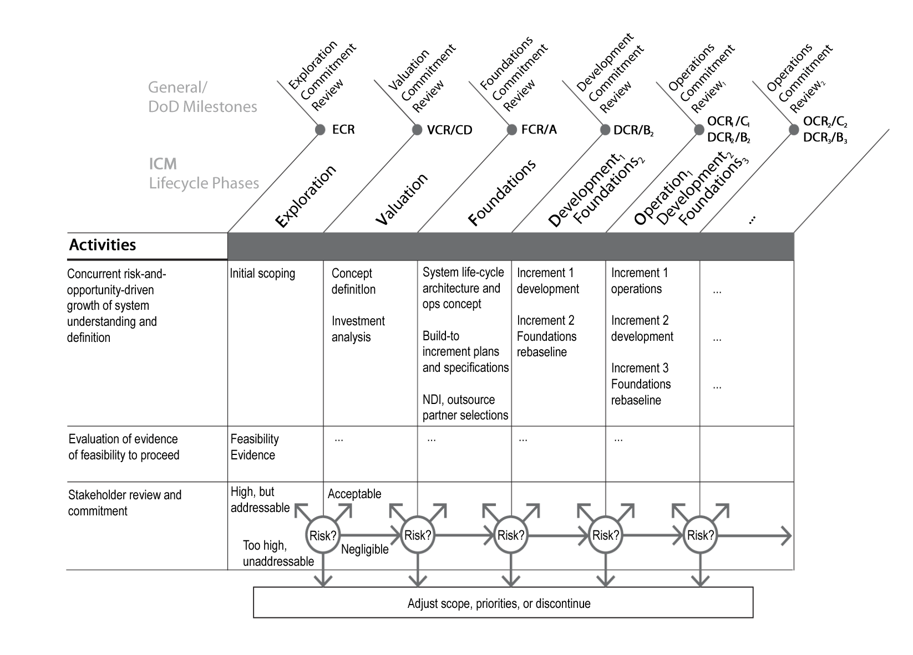
The Incremental Commitment Spiral Model
Notes:
This slide shows the overall concept of the ICM
Commitment and accountability
Success-critical stakeholder satisficing,
Incremental growth of system definition and stakeholder commitment,
Concurrent engineering,
Iterative development cycles,
Risk-based activity levels and milestones

Slide 4
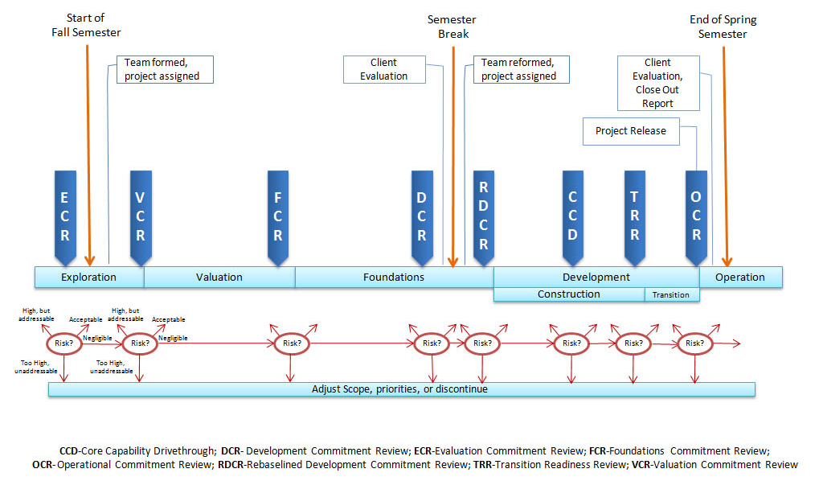
ICSM –Class Milestones

Slide 5
Software Engineering Project Clients
2006-2008
E-services
Neighborhood projects

Slide 6
Software Engineering Students
Graduate level
15-20 teams
6 on-campus, 2 off-campus students
Roles
  Project Roles
    Operational Concept Engineer, Requirements Engineer, Prototyper, UML Modeler, Software Architect, Life Cycle Planner, Feasibility Analyst, Quality Focal Point, Independent Integrated V&V, Coder, Tester, Trainer, Project Manager
  WinWin Negotiation Roles
    Personal Knowledge Contributor, Shaper

Slide 7
Risk Management in the class
Lectures
Individual Assignments
Team Assignments
  Weekly risk report (top n risks)
    Risk Exposure = Probability(risk)*Size(risk)
    Mitigation plan
  Milestone risk presentation
Notes:
Risk management is a core activity in CSCI577ab. On a weekly basis, by using the Distributed Assessment of Risks tool (DART), all team members have to brainstorm to identify the risks. For each risk item, each team member identifies the probability of risk occurrence (0-10) and the size of loss (0-10) in order to identify risk exposure for each risk item. Risk exposure can be calculated by multiplying the probability of loss to the size of loss. Team members, together with the clients, discuss the resulting risk mitigation plans. The project manager takes the top ten risks and reports them in his/her weekly progress report. Additionally, for each milestone, the teams have to present their current risks and mitigation plans to the architecture review board as evidence of project feasibility. The authors, as the course staff, review and monitor the project risks.

Slide 8
Risk Category | Example of risk items
Architecture complexity; quality tradeoffs | Maximum optimization system design; Design modules for future evolutionary needs
Budget, schedule and resource constraints | 24 week development schedule; Zero monetary budget
COTS and other independently Evolving systems | Unknown COTS infrastructure, unreliable COTS performance, COTS interoperability, future scalability
Customer-developer-user team cohesion | Off-campus students work full time in different time zone, difficult to find a good meeting time slot
Personnel shortfalls | Lack of technical and software engineering knowledge; unknown maintainer
Requirements mismatch | Requirements-architecture mismatch
Requirements volatility; rapid change | New stakeholders emerge with different visions, hence different requirements.
User interface mismatch | GUI may be too complex for non-technical users
Process Maturity | Possibility of inconsistent data due to team members not following the configuration management plan
Lack of domain knowledge | Learning curve about domains such as health care and business processes; Beyond Computer Science scope
Acquisition and contracting process mismatches | Often the clients are unable to provide special devices for testing as initially envisioned
Others | Migration complexity

Slide 9
Data Gathering
86 teams from Fall 2005 – Spring 2010
From weekly risk report
  Risk item
    Probability of Loss
    Size of Loss
    Ranking
  Risk age: Number of week each risk item exists in the project

Slide 10
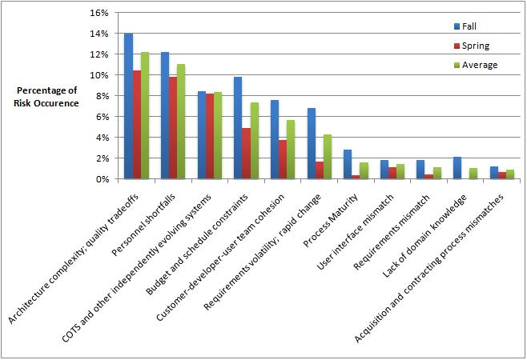
Percentage of Risk Occurrence by Category

Slide 11
Percentage of Risk Occurrence by Category
Higher Risks in Fall Semester
Except COTS and other independently evolving system

Slide 12
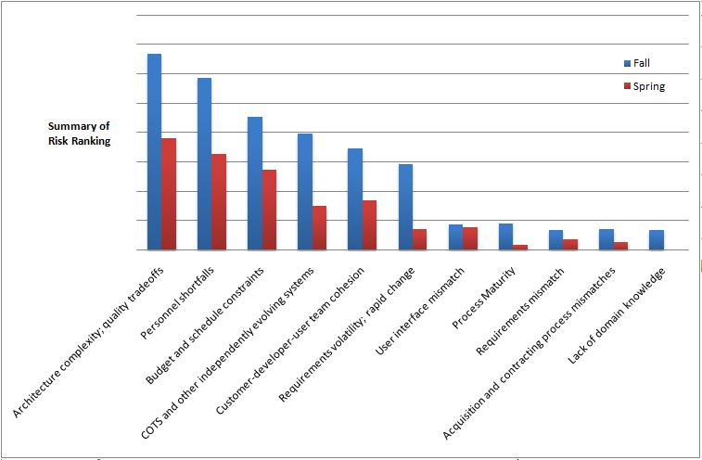
Summary of Risk Ranking by category
Higher Risks in Fall Semester
Except UI mismatch

Slide 13
Summary of Risk Ranking by category

Slide 14
Top 10 Risks in Software industry (2007) | Top 10 Risks in Software engineering class (2010)
1. Architecture complexity, quality tradeoffs | 1. Architecture complexity, quality tradeoffs
2. Requirements volatility | 2. Personnel shortfalls
3. Acquisition and contracting process mismatches | 3. Budget and schedule constraints
4. Budget and schedule | 4. COTS and other independently evolving systems
5. Customer-developer-user | 5. Customer-developer-user team cohesion
6. Requirements mismatch | 6. Requirements volatility
7. Personnel shortfalls | 7. User interface mismatch
8. COTS | 8. Process Quality Assurance
9. Technology maturity | 9. Requirements mismatch
10. Migration complexity | 10. Acquisition and contracting process mismatches

Slide 15
Top 10 Risks in Software industry (2007) | Top 10 Risks in Software engineering class
1. Architecture complexity, quality tradeoffs | 1. Architecture complexity, quality tradeoffs
2. Requirements volatility | 2. Personnel shortfalls
3. Acquisition and contracting process mismatches | 3. Budget and schedule constraints
4. Budget and schedule | 4. COTS and other independently evolving systems
5. Customer-developer-user | 5. Customer-developer-user team cohesion
6. Requirements mismatch | 6. Requirements volatility
7. Personnel shortfalls | 7. User interface mismatch
8. COTS | 8. Process Quality Assurance
9. Technology maturity | 9. Requirements mismatch
10. Migration complexity | 10. Acquisition and contracting process mismatches

Slide 16
Top 10 Risks in Software industry (2007) | Top 10 Risks in Software engineering class
1. Architecture complexity, quality tradeoffs | 1. Architecture complexity, quality tradeoffs
2. Requirements volatility | 2. Personnel shortfalls
3. Acquisition and contracting process mismatches | 3. Budget and schedule constraints
4. Budget and schedule | 4. COTS and other independently evolving systems
5. Customer-developer-user | 5. Customer-developer-user team cohesion
6. Requirements mismatch | 6. Requirements volatility
7. Personnel shortfalls | 7. User interface mismatch
8. COTS | 8. Process Quality Assurance
9. Technology maturity | 9. Requirements mismatch
10. Migration complexity | 10. Acquisition and contracting process mismatches

Slide 17
Risks found more often in Software Engineering Class
No/unknown Maintainer
Process maturity and quality assurance
  High learning curve
Acquisition
  Budget constraints
Personnel capability
  limited software development experience

Slide 18
Risk-driven software development

Slide 19
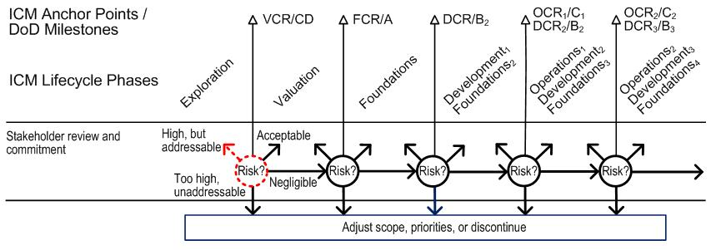
Too risky to continue

Slide 20
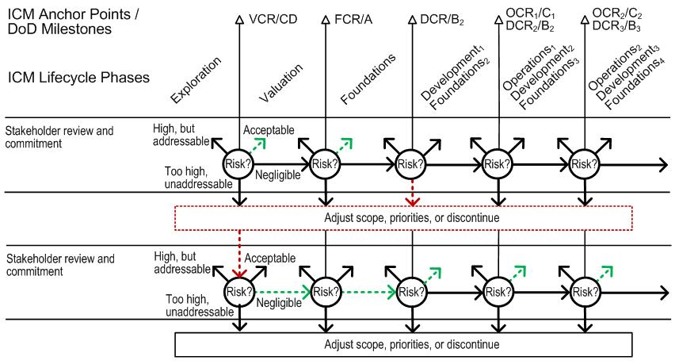
Found a COTS, change process

Slide 21
Conclusion
Risk assessment and management in up-front class material
More risk-related assignments help improving project success rate
Risk & Value-based mindset
New technologies → new pattern of risks
Additional guidelines, supplementary materials

