Slide 1
Teaching Software Design with Social Engagement
Damian A. Tamburri, M. Razavian, P. Lago

Slide 2
Roadmap
Where it all starts: Sw. Design Challenges
Core Tenets of our course
Design Projects
Week Structure
Peer-Review Clusters
Student Population and Evaluation Scheme
Discussions and Lessons Learned
Conclusions

Slide 3
Where it all starts: Sw. Design Challenges
PROCESS
RESULTS
designing software is finding equilibrium among design alternatives agreed by stakeholders
designers are constantly called to make, and consent with, design decisions
designs have value if their customers perceive it
Accountable and Rational Design Decisions
Design is Collaborative
Design is Iterative
^{“Social” Design}
Notes:
Most if not all of these activities have a deep social underpinning

Slide 4
Core Tenets of our course
Software design should be taught within a professional learning community
Social engagement of students should takes the upper hand
Students should be given a challenging, real-life project from an industrial partner
Student teams should be organized in collaborative clusters
Students’ mutual learning should be inspired through peer-reviewing and competition

Slide 5
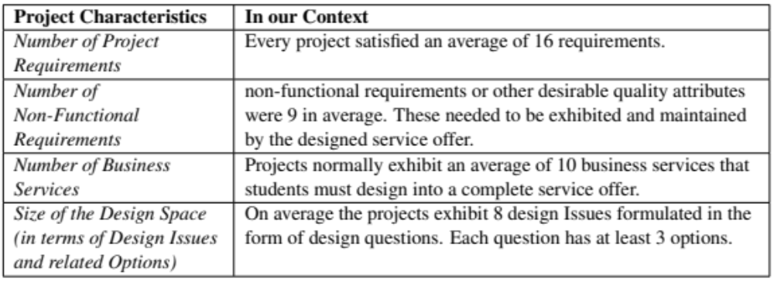
Design Projects

Slide 6
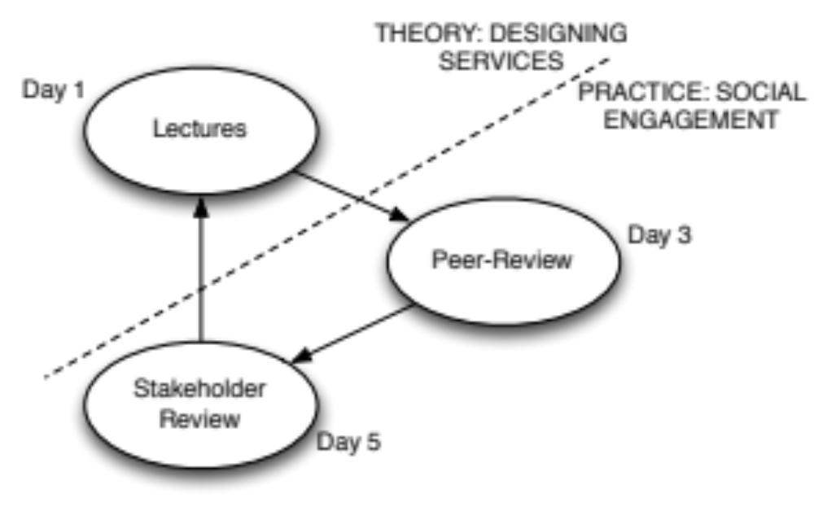
Week Structure
What We are teaching
How

Slide 7
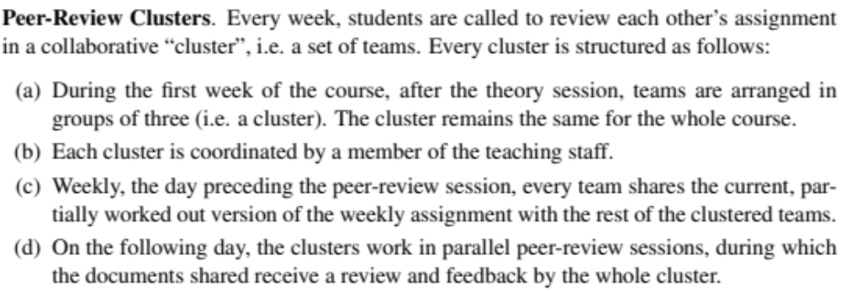
Peer-Review Clusters

Slide 8
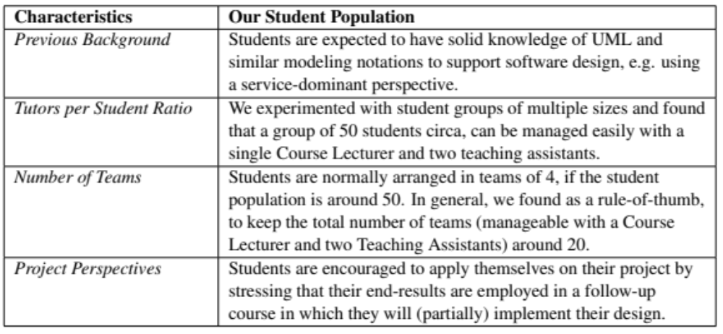
Student Population

Slide 9
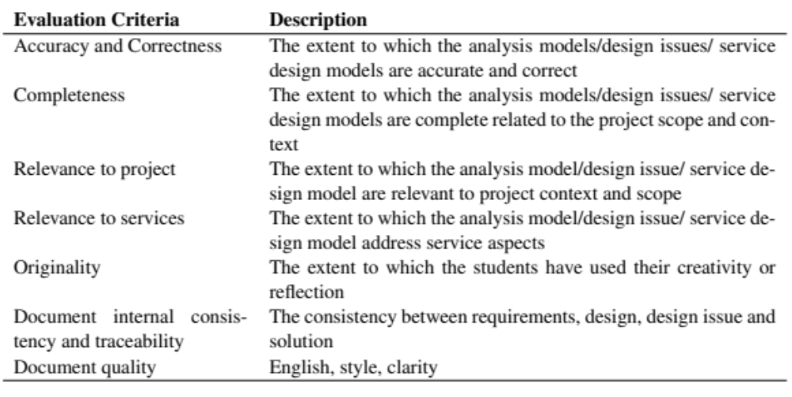
Evaluation Scheme

Slide 10
Discussions & Lessons Learned
Peer-review clusters need to be steered by means of fixed and written guidelines.
Students must be provided with a clear-cut explanation of the learning objectives of each session, very early in the course.
Lecturers should steer peer-reviews by:
    (i) setting clear expectations;
    (ii) ensuring that non-performing members are held;
    (iii) setting internal deadlines for teams;

Slide 11
Conclusions
Sw. Design is a Social activity… teaching and learning it should become equally social
Our design course efficiently delivers a balance between theory, practice and social aspects of software design… BUT:
  Needs for more systematic structuring
  Needs for more effective steering mechanisms of clusters

