Slide 1
Automated Evaluation of Regular Lab Assignments: A Bittersweet Experience?
(CSEE&T 2013, San Francisco)
Pavel Ježek
Michal Malohlava
Tomáš Pop

Slide 2

Charles University in Prague
Established in 1348 (by Charles IV, King of Bohemia and Roman Emperor)
  1781-1848: Bernard Bolzano
  1803-1854: Christian Doppler
  1911-1912: Albert Einstein
Largest university in Czech Republic:
  17 faculties
  4500 academic and research staff
  53000 students in all programs
Faculty of Mathematics and Physics:
  School of Mathematics
  School of Physics
  School of Computer Science
Public university
  Top universities in Czech Republic: public (free)
  “Last-choice” universities: private (paid)

Slide 3
Context (Czech Rep. + Other Central Europe)
A few years ago a typical university program in Czech Republic = a 5 year Master program
However: Bologna Process in 1998 – key points:
  Easy transfers of students between EU (Bologna Process) countries
  More attractive study programs for non-EU students
  Common system of credits (60 ECTS credits per year)

Slide 4
Bologna Process Implementation 1/2
Bologna Process – intended as a set of guidelines, not a strict requirement
Implementation in Czech Republic – Study programs:
  3 year Bachelor program
  2 year Master program
  + very few exceptions (e.g. Medical Faculties – 6 year M.D. programs)
Result: original 5 year Master programs “randomly” split into 3 year Bachelor + 2 year Master programs → most students continue with a Master program after acquiring a Bc. degree

Slide 5
School of Computer Science
Bachelor programs (3 years):
  Theoretical Informatics (math)
  Computer Science
Master programs (2 years):
  Theoretical Informatics (math)
  Computer Science
5 year Bc CS + MS CS “program” ≈ 4 year US undergrad CS (Computer Science) + SwE (Software Engineering) programs

Slide 6
Brief CS “Program” (Bc + MS) Overview
1st semester (14 weeks): Programming fundamentals (algorithms and data structures) + Intro to Computer Design and Architectures and Operating Systems + Intro to Networking
2nd semester (14 weeks): Intro to OO + further algorithms and data structures
3rd semester: Complex OO and basic SwE concepts in native (C++) and managed (C#/.NET or Java) environments
4th to 10th semester: several advanced SwE courses (TDD, MDD, team projects, agile, XP, etc.)

Slide 7
C# Language and .NET Platform Course
Basic concept similar to parallel C++ and Java courses
Lectures + labs (1 PhD student per 1 lab group, no other teaching assistants)
Goals:
  Understanding of concepts behind technologies
  Practice complex OO concepts
  Practice basic SwE concepts (unit testing, design, design patterns)
Labs:
  Every week assignments – evaluated and discussed directly in labs

Slide 8
Problem
Bad results of many student in evaluations at the end of semester
Evaluations in most courses only at the end semester

Slide 9
Change Introduced for 2010/2011
Regular lab assignments as before (every week) – but require 70% to pass the course (1 week deadlines)
Automated evaluation system
  Similar to “ACM contests”
  Testing (correctness, time and memory demands)
  Results (OK, TIME LIMIT, MEMORY LIMIT, WRONG RESULT)
  Accepts only solutions passing 100% of tests
  Does not give any feedback about code quality yet.
Expected several problems

Slide 10
Bologna Process Implementation 2/2
Implementation in Czech Republic – Credits:
  Each university (each faculty at our university) uses only ECTS credits, but defines what is worth a single ECTS credit
  Faculty of Mathematics and Physics: Approach to Bologna Process adoption (final compromise of faculty board + student senate): 60 divided by a magic constant → 1 hour (45 minutes) = 1,5 ETCS credits
  Course with 2 hours/week lectures + 2 hours/week labs = 6 ECTS credits (so typical course yields 3 or 6 ECTS credits)
  Another example: faculties of arts – typical course yields 1 or 2 ECTS credits

Slide 11
Change Introduced for 2010/2011
Regular lab assignments as before (every week) – but require 70% to pass the course (1 week deadlines)
Automated evaluation system
  Similar to “ACM contests”
  Testing (correctness, time and memory demands)
  Results (OK, TIME LIMIT, MEMORY LIMIT, WRONG RESULT)
  Accepts only solutions passing 100% of tests
  Does not give any feedback about code quality yet.
Expected several problems

Slide 12
Cons
Increased workload for lab assistants
  Automated evaluation system saves a lot of time before a correct solution is submitted
  But:
    Interaction with students is still needed (“I’m 100% percent sure my solution is correct, but it fails. There must be a bug in the evaluation system.”)
    We want to give students comments about quality of their design (= 5-20 minutes per 1 final solution)

Slide 13
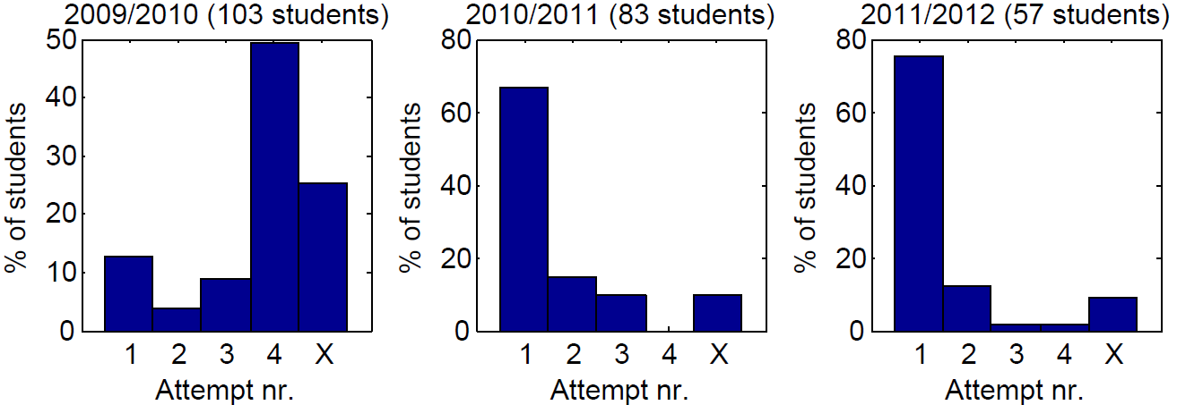
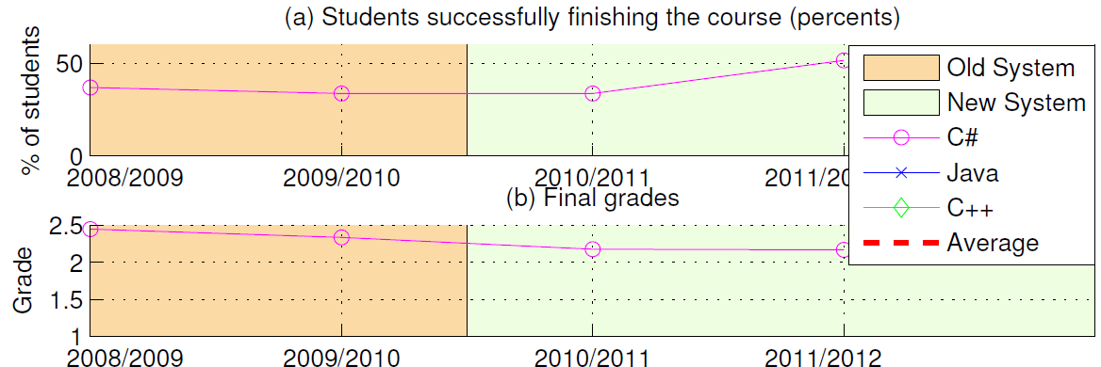
Pros: Student Skills / Cons: Student Interest

Slide 14
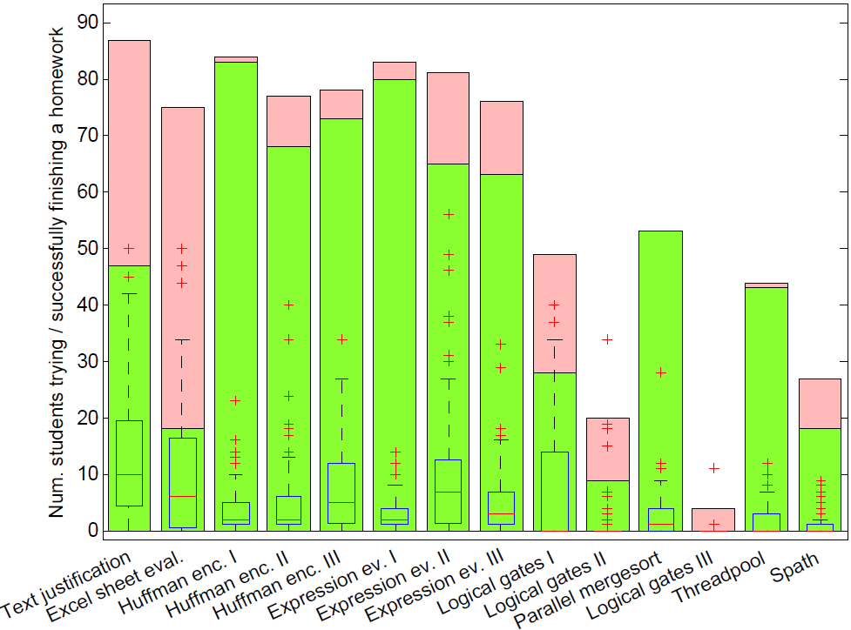
Pros: Quick Adaption & Student Skills
Quick adaptation
Automated evaluation → allows to require 100% correct solutions → forces students to: create their own unit tests, focus on the design (apply design patterns)

Slide 15
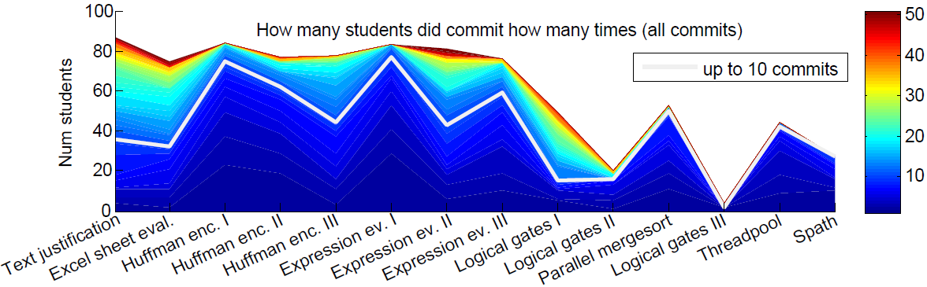
Pros: Quick Adaptation

Slide 16
Thank you!
Questions/Comments?

