Slide 1
Motivating and Orienting Novice Students to Value Introductory Software Engineering
Daniel Port, Chris Rachal, Jia Liu
University of Hawaii x 2, USA; Nanjing University, China

Slide 2

Our Novice Students Were Poorly Oriented and Motivated to Study SWE
“I’ve been successful without all this.”
“The instructor was enthusiastic about content but sometimes the content wasn’t interesting to me and other students”
“Why do we need to do so much documentation?”
“All this process stuff just gets in the way of programming ”
“Did not really have motivation to learn besides get a good grade”
“I did not find any of the new material to be interesting. I thought UML was not useful at all.”

Slide 3
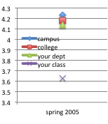
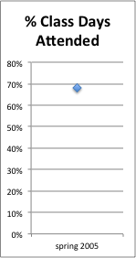
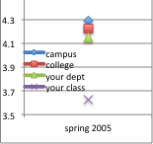

Palpable Consequences…
Seriously?!?
I learned a lot in this course
The instructor stimulated me to think about the subject matter
US
After course survey:
# type / total responses
poor class performance
Negative perception of course from students
negative perception from employers of student preparation for jobs
students not pursuing or poor success with software engineering careers

Slide 4

But We Know Software Engineering is Important For Our Students!
… I thought I would spend most of my time programing, but it’s all about requirements, documentation, and project management just like you said. I wish I paid more attention in ITM353.”

Slide 5

We Tried …
We knew there was a problem, but were not sure exactly what is was.
We tried the usual prescriptions:
  Real-client projects
  Adopting agile methods
  New textbooks purporting modern, innovative learning approaches
  Infusing software engineering concepts into pre-requisite courses (Introductory Programming)
  Active Learning / engagement / in-class activities

Slide 6
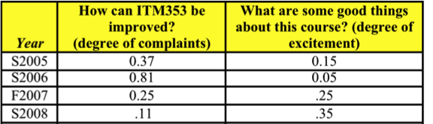
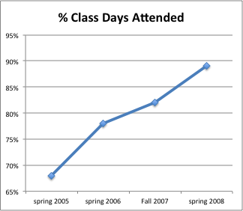
Some Improvement!
New textbook
Real-projects
Infusion
The instructor stimulated me to think about the subject matter
I learned a lot in this course

Slide 7

But …
Also quality of work did not improve substantially
With real-projects students did tend to appreciate SWE but only after “being burned” or “after the fact”
  Not always a positive experience → frustration, discouragement, resentment
  Poor application of material →1st time around, retention
A survey after the course was over found students had:
  little understanding of the relevance and utility of the course material
  low motivation and interest in the course
  lack of confidence and enthusiasm in pursuing software engineering jobs after graduation

Slide 8
Lack of Motivation and Orientation
Primary problem is that novice students tend to lack motivation and are poorly prepared (oriented) to appreciate the study and practice of software engineering.
From the start of the course need to foster:
  Intrinsic motivation (self-fulfillment, enjoyment, satisfaction)
  Extrinsic motivation (perceptions of current and future success)
BIG FAT CLUE:
  The more experienced the student, the more motivated and oriented they tended to be from from from the start
DUH?!?
But Why?

Slide 9
Educational Psychologists Say …
Students should be given an opportunity to explore for themselves the how the course material can help achieve future goals. This is the future time perspective (FTP)
Students should acquire an understanding of the instrumental value of present behavior (IVPB) for future goals.
Barbra Grosses book “Tools for Teaching” suggests:
  Give frequent, early, positive feedback that supports students' beliefs that they can do well. (FPF)
  Ensure opportunities for students' success by assigning tasks that are neither too easy nor too difficult. (EZ)
  Help students find personal meaning and value in the material. (PMV)
  Create an atmosphere that is open and positive. (OPA)
  Help students feel that they are valued members of a learning community. (LC)

Slide 10

Four Engagements
Developed four “early awareness engagements” specifically to implement suggestions
Done before topics that have been difficult to motivate (e.g. SDLC, project roles)
Practical, quickly and easily implemented within any kind of course, high-impact, low-effort

Slide 11
Engagement 1: Interview a Professional
Assignment 1
Your task is to interview an “MIS professional” about SAD (Systems Analysis and Design) topics. The main question to answer is:
“What should a successful MIS person know about SAD?”
1) You will work with up to two partners, as assigned. Your team will choose an MIS professional to interview, or you may request to interview an MIS professional you know personally.
You will contact the MIS professional assigned to your team as soon as possible and set up an interview time. You may interview by phone, but in person interview is recommended if possible.
http://itm-vm.shidler.hawaii.edu/itm353/asst1.html

Slide 12
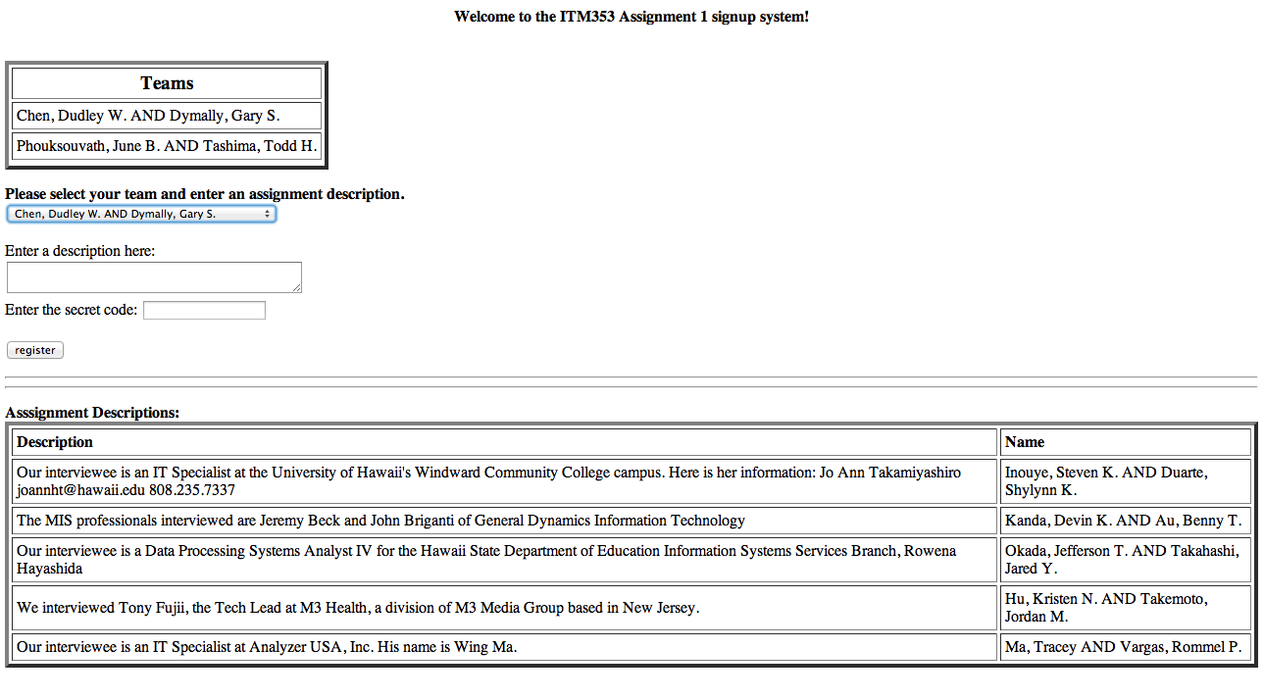
Sign-up Example

Slide 13
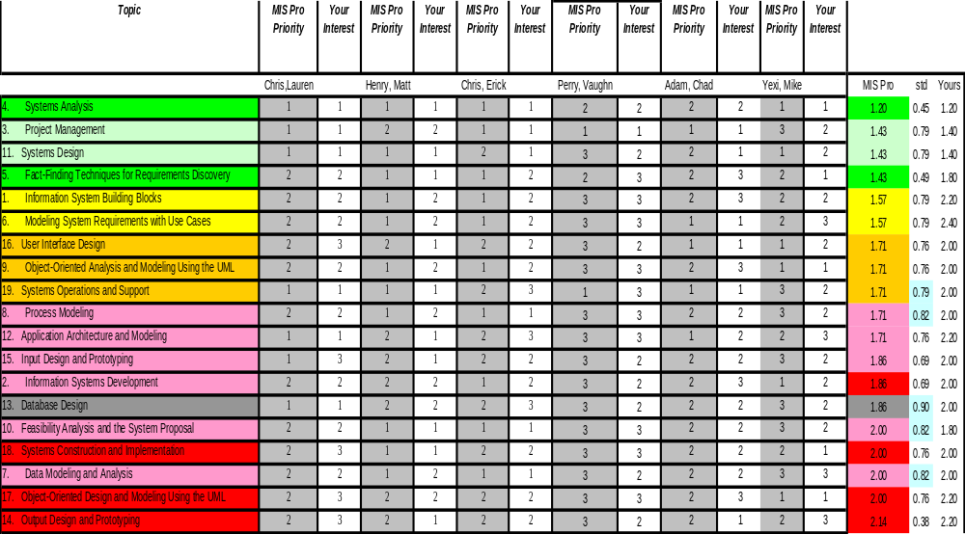
Example Results

Slide 14
Other
Should we have some programming exercises throughout the course so you can keep up your hard-won programming skills? In the past I have received post-course feedback expressing frustration that there was no programming for nearly the entire semester and some students "forgot" how to program. Then at the end of the course, their team project required them to do some programming and they had to re-learn PHP.
  Yes: No: Other ideas: IT Application Security
Should the class have a real-client team project? In the past this has been very useful for putting a lot of the abstract material and concepts into actual practice.
  Yes: No: Other ideas:

Slide 15
Other
Guest speakers on special topics - how many? what topics? who?
  Yes: No: Other ideas:
We have access to a number of industry popular tools such as MSProject and Visio. They are complicated and take time to learn. Should we have some training in their use or just make them available?
  Yes: No: Other ideas:
Student teaching. I have found that when you have to prepare a class, you learn a lot and appreciate the material more. Should we have teams of students prepare and present course topics (with my help of course)?
  Yes: No: Other ideas:

Slide 16
ITM353 Fall 2008
Topics
  ■ = light/no focus
  ■ = heavy focus
X guest speakers (ITS, HA, ???, ???)
Student team teaching (max 3 people)
Class long team project (optional real-client)
Small programming assignments related to topics
1. Information System Building Blocks
2. Information Systems Development
3. Project Management
4. Systems Analysis
5. Fact-Finding Techniques for Requirements Discovery
6. Modeling System Requirements with Use Cases
7. Data Modeling and Analysis
8. Process Modeling
9. Object-Oriented Analysis and Modeling Using the UML
10. Feasibility Analysis and the System Proposal
11. Systems Design
12. Application Architecture and Modeling
13. Database Design
14. Output Design and Prototyping
15. Input Design and Prototyping
16. User Interface Design
17. Object-Oriented Design and Modeling Using the UML
18. Systems Construction and Implementation
19. Systems Operations and Support

Slide 17
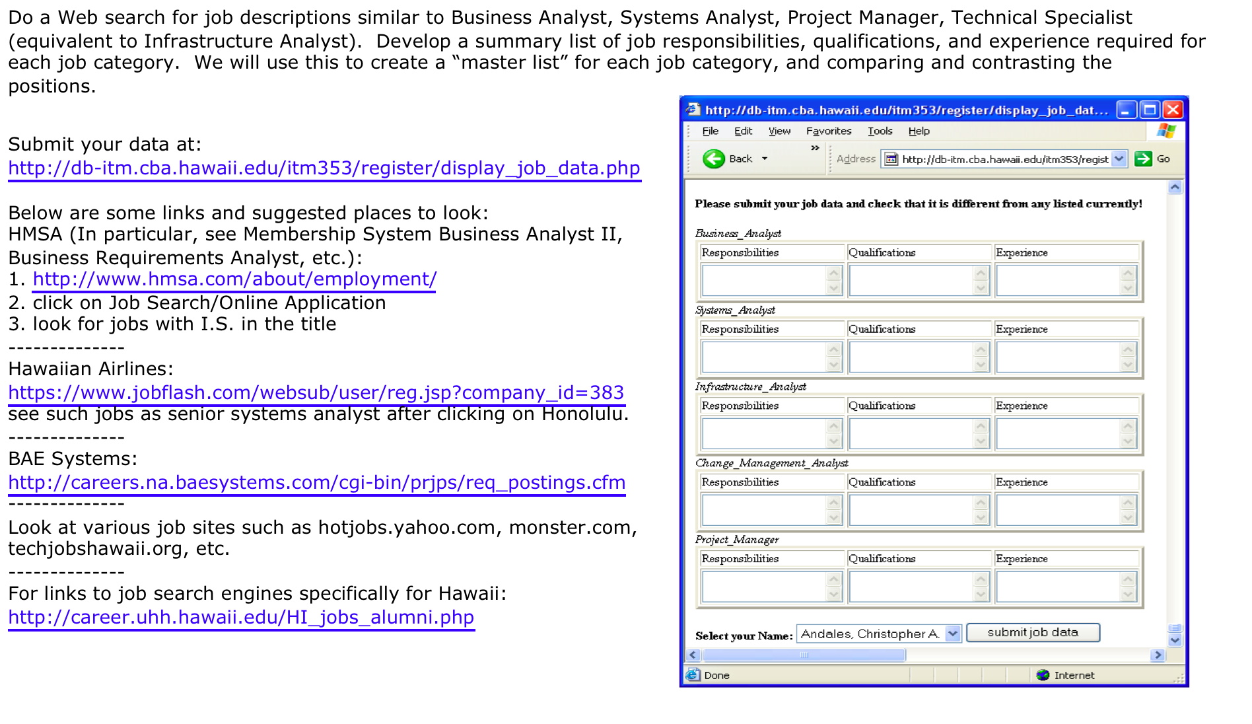
Engagement 2: Subject Matter and Real-World Job Skills

Slide 18
(back to the) Future Value
Exercise is linked to a discussion of project planning and roles and planning for their semester-long projects.
In these projects the students had to adopt various project roles (project leader, infrastructure analyst, business analyst, etc.) and this exercise
  convinced them that such positions really did exist in the world, and
  helped them understand the kinds of skills that they would need to undertake such a position.
In 10 minutes the students would collectively gather dozens of job descriptions, which were later viewed using this same PHP script.
As a group we would then review the collected job descriptions to reinforce the kinds of duties, skills, and knowledge that employers associating with each position.
Students are excited to see the list of potential jobs they might be eligible for in the future pile onto the screen during class!

Slide 19
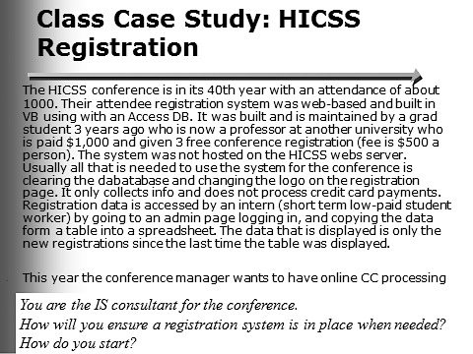

Engagement 3: Live Throughs
Any student that can provide a feasible and convincing recommendation for implementing the system within the next 30 minutes (recall that they were expected to review the case study long before class) will immediately be awarded an A+ and is excused from any further work in the course.
REAL

Slide 20
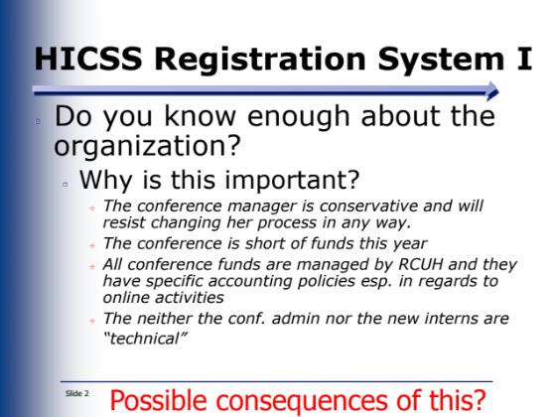
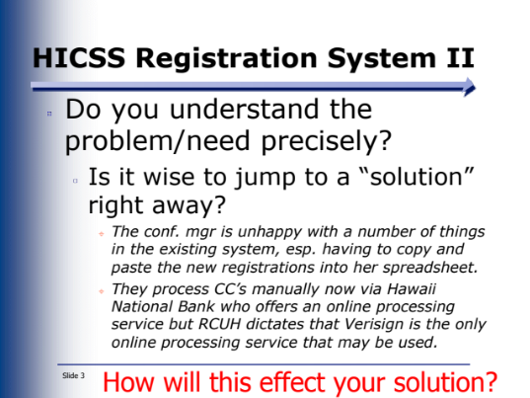
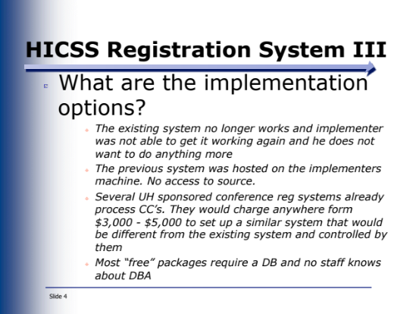
The Questions Not Asked …
Have not given automatic A+ yet
Leads to very productive discussions and insights into SWE

Slide 21
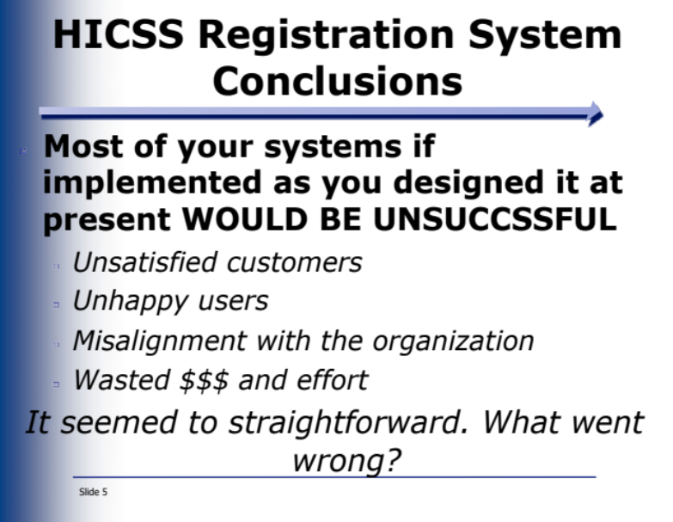
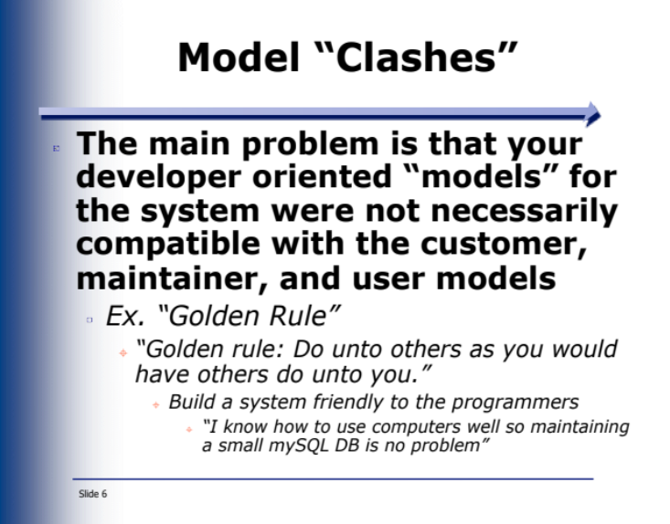
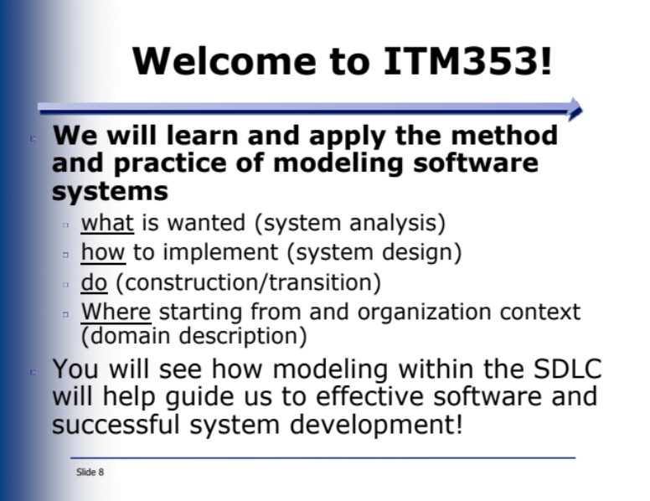
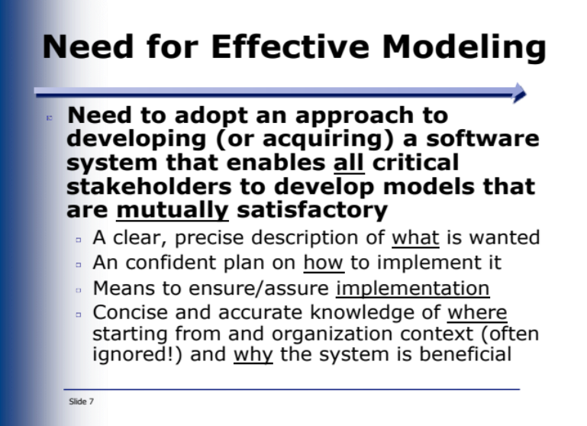
Productive Discussions!

Slide 22
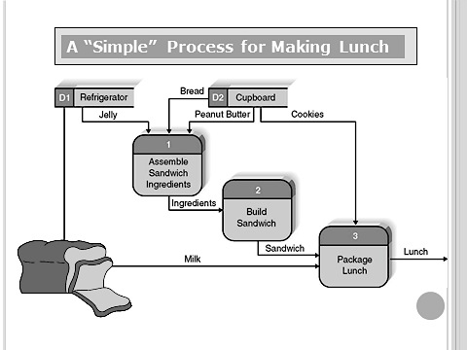
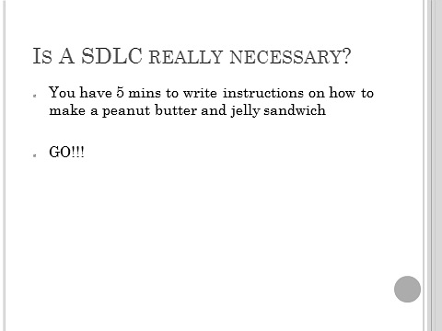
Engagement 4: Making A Sandwich and the SDLC

Slide 23
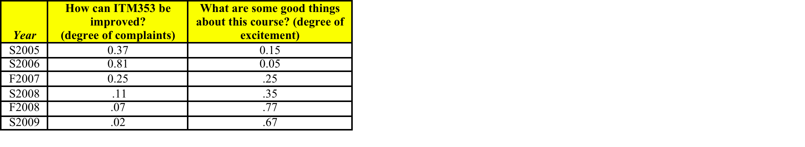
So?
#9 the instructor stimulated me to think about the subject matter
#7 I learned a lot in this course
Oh, by the way, I now enjoy teaching this class.
Thank you for listening and I’m happy to share the details of the four engagements.
#14 The Instructor Sets High Standards
WoW!

