Slide 1
AI impact on the environment
Projections and remedies
GREGORY LEBOURG
GLOBAL ENVIRONMENTAL DIRECTOR

Slide 2
00
Assessing the AI impact on the environment, where are we ?

Slide 3





“Only can we solve a problem by assessing it correctly”
We see more and more research papers being published
AI impact on the environment

Slide 4



We are not there yet…
Misaligned methodologies and wilful bad faith (?) blur the picture
1 gCO2e per prompt
45 ml per prompt
0.03 gCO2e per prompt
0.26 ml per prompt
AI impact on the environment

Slide 5
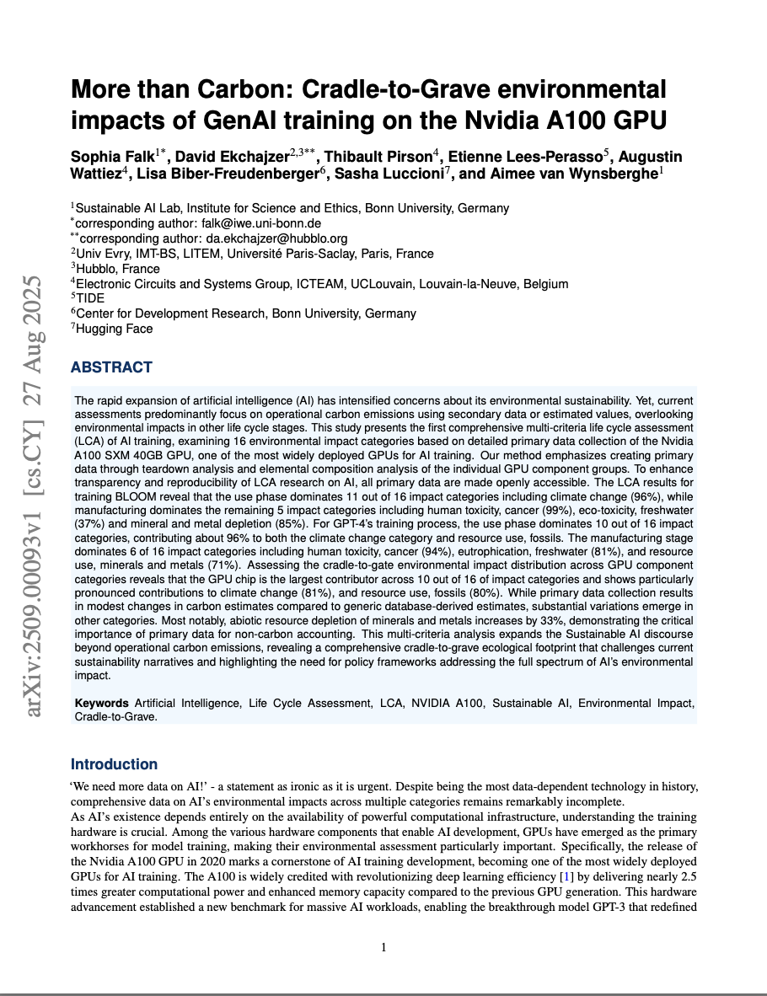
But there is hope !
Countless independent and rigorous scientific studies are released
AI impact on the environment

Slide 6
01
Data centers
utilities demand

Slide 7
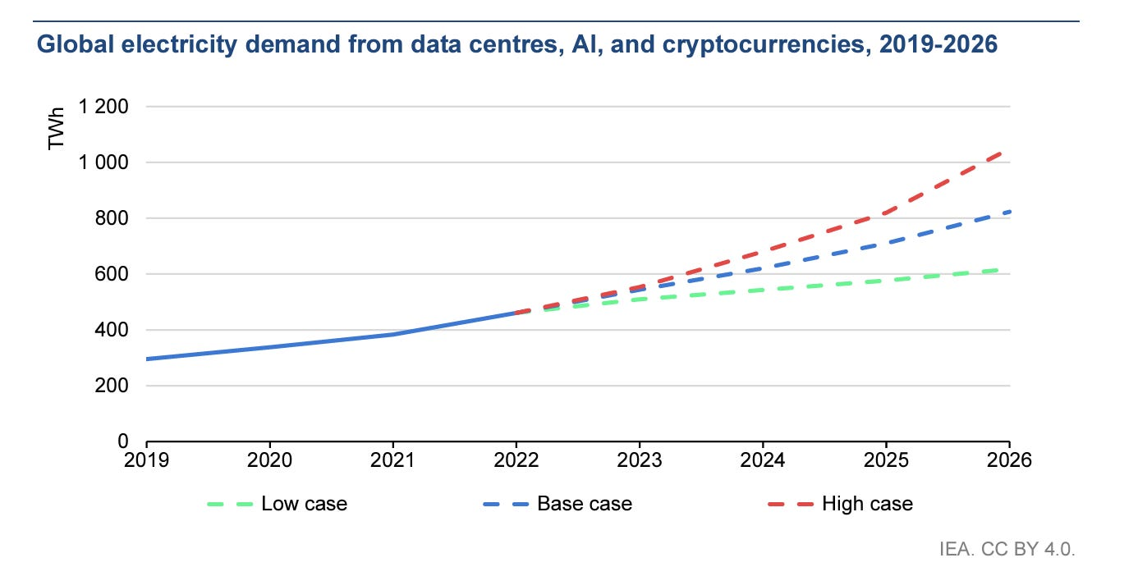

Early 2024 findings : DC use around 1 to 2% of the world’s electricity
AI & cryptocurrency included it’s around 460TWh in 2022 (IEA Jan. 2024)
+900 TWh ?
2030
AI impact on the environment

Slide 8
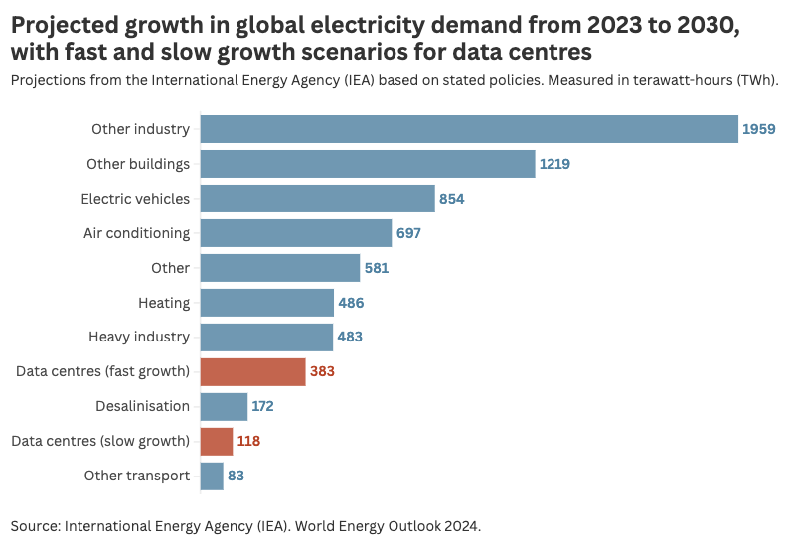

Late 2024 findings : projections are uncertain due to AI effect
Update says demand growth by 2030 would be around 250 TWh (IEA Oct. 2024)
Among which 85-134 TWh for AI*
*Source – Dr Alex de Vries VU Amsterdam School of Business and Economics
AI impact on the environment

Slide 9
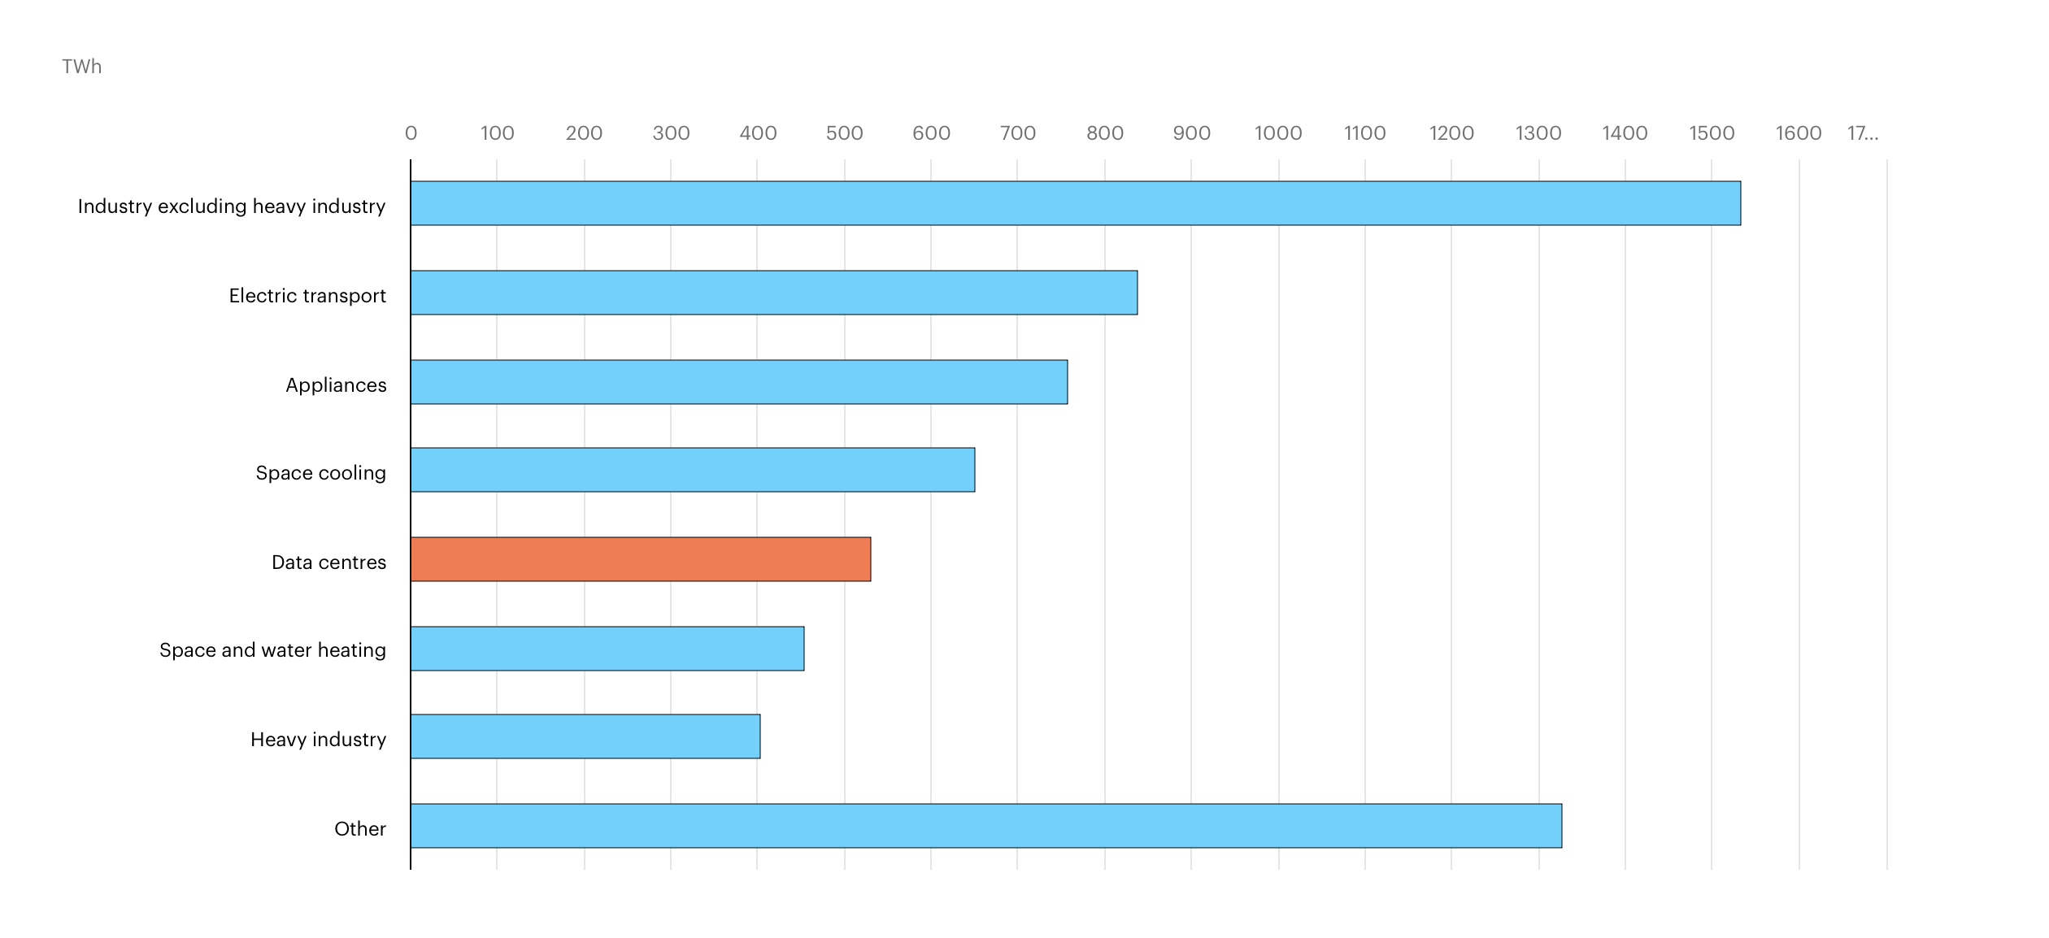
Early 2025 findings : refined models are changing again the perception
Update says demand growth by 2030 will around 500 TWh (IEA Apr. 2025) starting from a 415 TWh base in 2024
AI impact on the environment

Slide 10
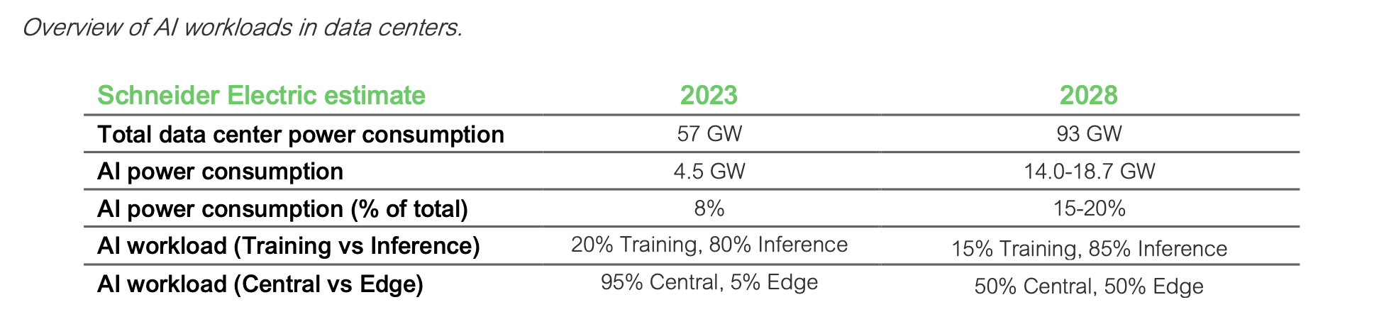
AI workloads – what for and where ?
Mid-term there will be a shift from training to inference changing the geographical spread
Source – Schneider Electric Energy Management Research Center – SPD_WP110_EN V3
AI impact on the environment

Slide 11
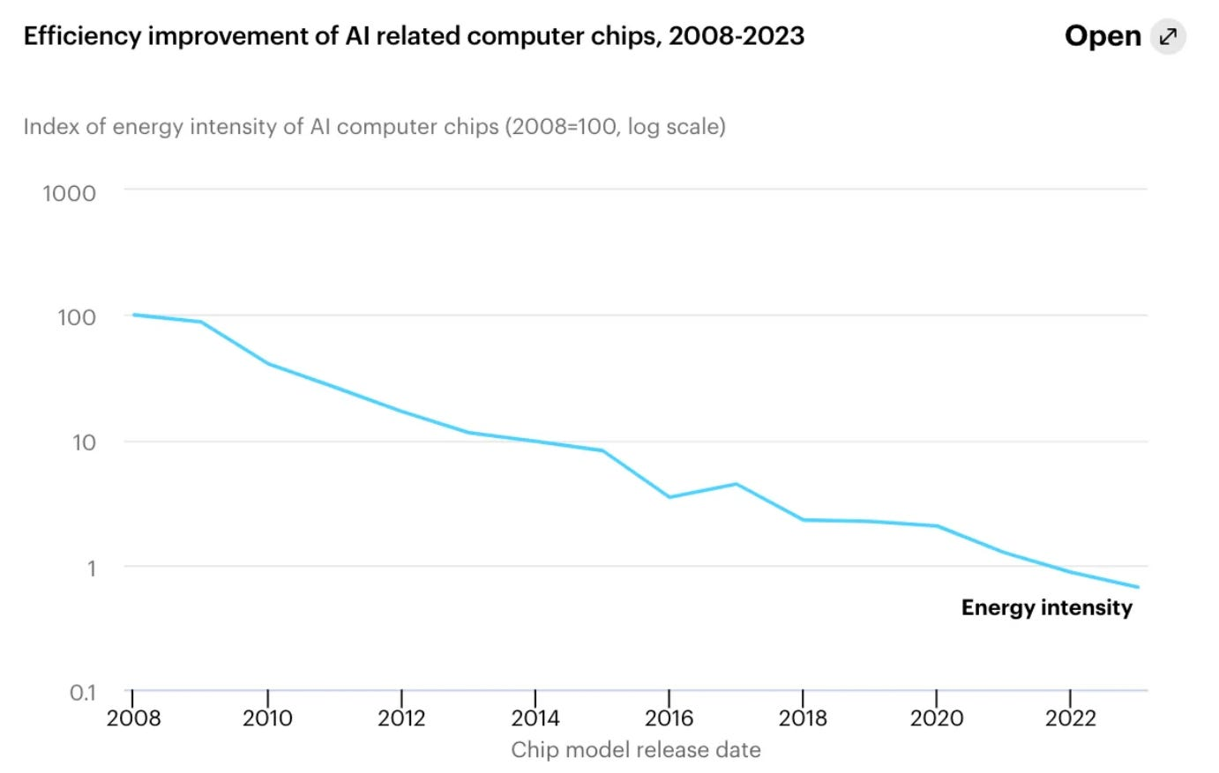
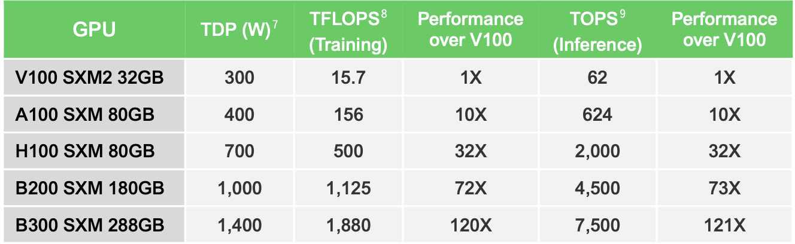
Boom in AI demand should be mitigated by chips efficiency improvement…
Between 2010 and 2018, global data centre compute increased by more than 550%, yet energy use in data centres increased by just 6% (Koomey’s Law).
AI impact on the environment

Slide 12



… together with a major shift towards liquid cooling technologies
Liquid Cooling efficiency dramatically improves the PUE (Power Usage Effectiveness)
AI impact on the environment

Slide 13

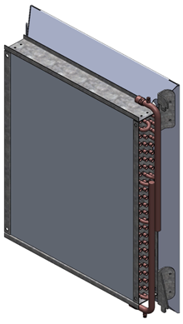
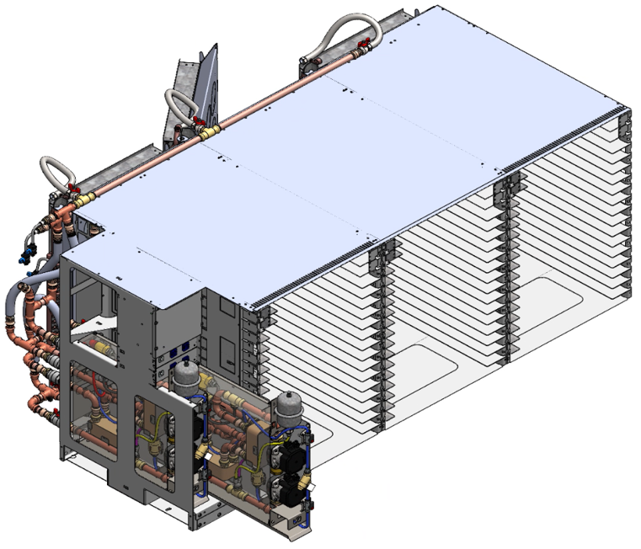



OVHcloud pioneered via its DLC/Indirect Free Cooling technology…
Introduced at scale (450 000 servers) 23 years ago
Power efficiency: OVHcloud PUE = 1.24 (1.26 previous year)
(vs 1.56 industry average plateauing over the last 4 years)
New design allows a PUE as low as 1.12
Autonomous rack
Water cooled CPU/GPU
AI impact on the environment
13

Slide 14
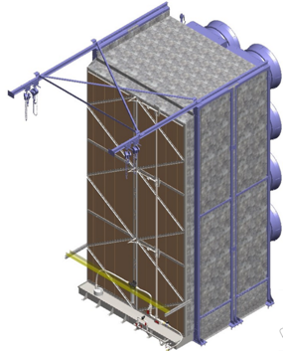
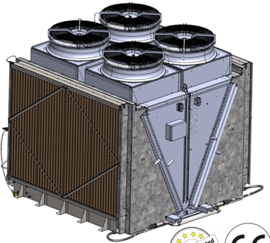
… while keeping the use of water very low
Due to OVHcloud water profile, evaporative cooling is working only when outside temp is above 25°C
Water efficiency: OVHcloud WUE = 0.34 l/kWh (0.37 l/kWh previous year) (vs 1.1 l/kWh industry average)
New design allows a WUE as low as 0.10 l/kWh
SlideIN dry cooler
V shaped dry cooler (VDC)
AI impact on the environment
14

Slide 15
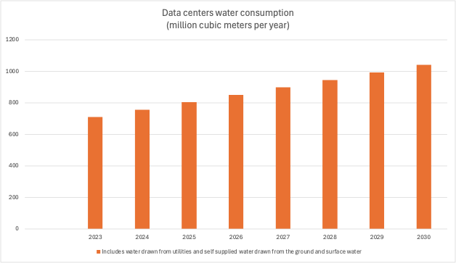

Overall data centers water consumption projections (scope 1 and 2)
Source – Bluefield Research
15
AI impact on the environment

Slide 16
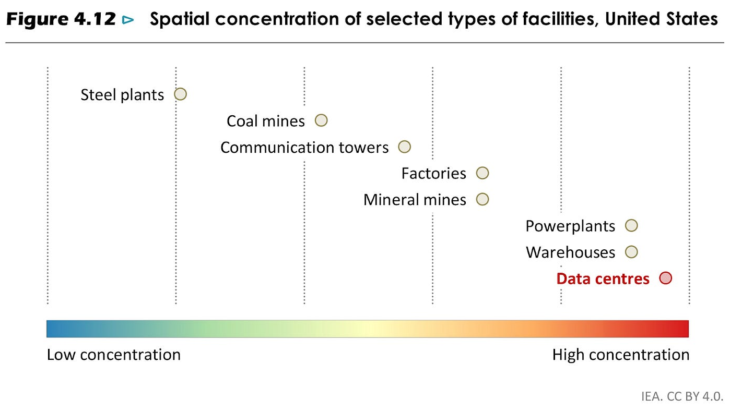
The AI impact on utilities is local
The spatial concentration of energy/water demand is extremely high for AI data centres with significant implications for local power grids and aquifers
AI impact on the environment

Slide 17
02
Beyond utilities
GHG emissions, abiotic resources and land

Slide 18
OVHcloud findings : scope 2 and 3 are highly impacted by GPU
Close to 30 000 GPU installed already (NVIDIA, AMD)
Introduced massively for parallel computing and the gaming industry
In average servers with GPU dedicated to AI consume 5x as much electricity as the average one
Typical LCA (from cradle to gate without uncertainty)* :
  Intel CPU range 5 – 25 kgCO2e
  NVIDIA GPU L4 50 kgCO2e
  NVIDIA GPU L40s 100 kgCO2e
  NVIDIA GPU A100 150 kgCO2e
  NVIDIA GPU H100 150 kgCO2e (163 kgCO2e**)
*Source – Intel PCF / OVHcloud LCA **Source – NVIDIA LCA
AI impact on the environment
18

Slide 19


OVHcloud findings : arbitration needs to happen as far as location
Choosing the right location to train the models
AI PaaS (NVIDIA® H100)
Poland
24.3 tCO2e (over 3 years)
AI PaaS (NVIDIA® H100)
Canada
3.6 tCO2e (over 3 years)
- 85%
kCO2e/month
(Location based)
Manufacturing 73
Operations 4
Electricity 598
kCO2e/month
(Location based)
Manufacturing 73
Operations 4
Electricity 23
Source – OVHcloud carbon calculator
19

Slide 20
AI critical minerals needs will compete with other usages
Demand for critical minerals experienced strong growth in 2023, with lithium demand rising by 30%
While demand for nickel, cobalt, graphite and rare earth elements all saw increases ranging from 8% to 15%
Clean energy applications have become the main driver of demand growth for a range of critical minerals
Electric vehicles (EVs) consolidated their position as the largest-consuming segment for lithium, and increased their share considerably in the demand for nickel, cobalt and graphite
Source – IEA Global Critical Minerals Outlook 2024
AI impact on the environment
20

Slide 21
Projections show a mixed picture for future supply-demand balances
Anticipated mine supply from announced projects meets only 70% of copper and 50% of lithium requirements
Balances for nickel and cobalt look tight relative to confirmed projects
Graphite and rare earth elements may not face supply volume issues but are among the most problematic in terms of market concentration: over 90% of battery-grade graphite and 77% of refined rare earths in 2030 originate from China
Source – IEA Global Critical Minerals Outlook 2024
AI impact on the environment
21

Slide 22
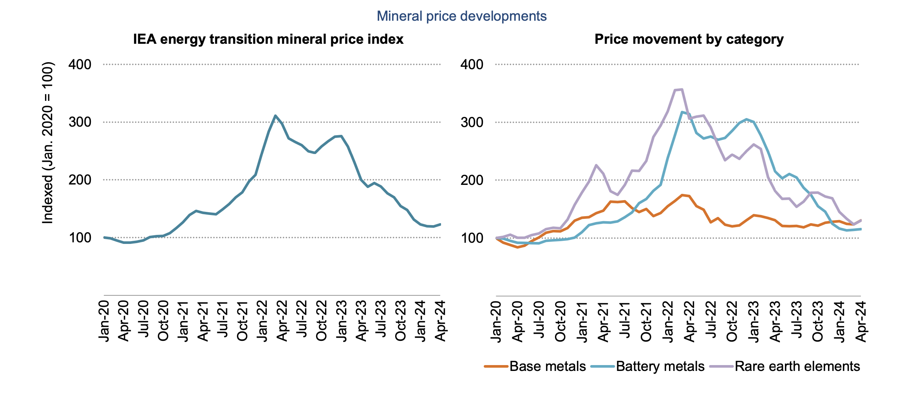
Prices for key minerals have returned to pre-pandemic levels
But experts project a price rise all across the board
Source – IEA Global Critical Minerals Outlook 2024
AI impact on the environment
22

Slide 23











OVHcloud findings : circularity becomes a must event for GPU
Reverse supply chain - OVHcloud components reuse ratio between 17% to 36%
Recycling
Cleaning &
dismantling
100% of servers are disassembled
Component testing
Destruction
End of life of servers in DC
Sale
Testing
Server up and running in DC
New components
Parts for manufacturing
Validation
Repair & refurbish
Manufac-turing
Components reset and reused for manufacturing
AI impact on the environment
23

Slide 24


OVHcloud findings : extending GPU lifespan is not an option
Low-end PCI compute platforms can be suitable for less demanding workloads
NVIDIA® Tesla V100
(Parallel computing)
June 2017
Public Cloud Compute
100%
NVIDIA® Quadro RTX5000
(Gaming)
August 2018
50%
AI impact on the environment
24

Slide 25

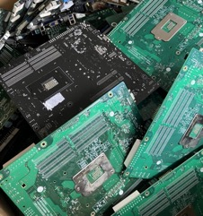

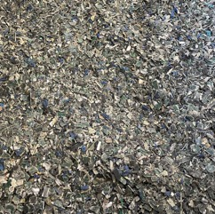
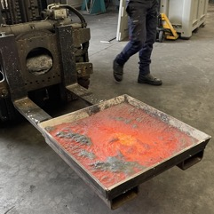
OVHcloud findings : minerals recovery for GPU needs to be addressed
Pyrolysis + electrolysis processes to recover Copper and aggregated Gold/Silver/Nickel/Palladium/Platinum from WEEE
Avoid
Reduce
Dispose
Reuse
Recycle
Incinerate
Reused components
(reverse supply chain)
CPU GPU (kg) | HDD (kg) | SSD (kg) | MB (kg) | RAM (kg) | TOTAL (kg)
350 | 2870 | 1550 | 2430 | 1320 | 8520
Resold components
(reverse supply chain)
1070 80 | 15440 | 730 | 8580 | 1170 | 27 070
Minerals recovery
(recycling chain)
220 180 | 9910 | 1030 | 15620 | 70 | 27 040
100%
25%
AI impact on the environment
25

Slide 26
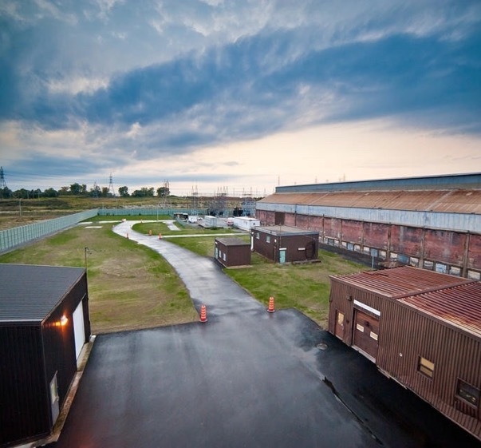
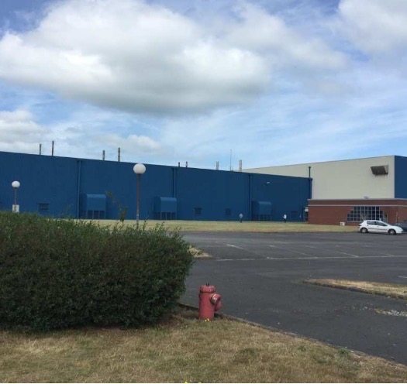

OVHcloud findings: Land artificialisation reduction via building revamp
Brownfield vs greenfield rate: 28 out of 31 OVHcloud owned DCs are old industrial buildings (31 out of 31 with no land artificialisation)
Beauharnois (QC, Canada)
Aluminium factory
Hillsboro (OR, USA)
Electronic pianos factory
Gravelines (France)
Canning factory
AI impact on the environment
26

