Slide 1
The Software Assurance Competency Model: A Roadmap to Enhance Personal Professional Capability
Software Engineering Institute
Carnegie Mellon University
Pittsburgh, PA 15213
Nancy R. Mead, PhD
Notes:
I am Nancy Mead with the CERT program at the SEI. I’ll be talking about a software assurance competency model as part of the summit on software assurance. I have two primary projects. They include a research project in requirements engineering, and client work. Today we will be discussing one aspect of work in support of Department of Homeland Security. The DHS work includes the Build Security In website, a study of business case models for software assurance, development of a master’s level Software Assurance Curriculum as part of the Software Assurance Curriculum Project, and the software assurance competency model that we will be discussing today.

Slide 2
Definition of Software Assurance
The following definition of software assurance is used:
Application of technologies and processes to achieve a required level of confidence that software systems and services function in the intended manner, are free from accidental or intentional vulnerabilities, provide security capabilities appropriate to the threat environment, and recover from intrusions and failures.
Notes:
We are big on definitions, and the definition of software assurance is one that we have carried throughout our curriculum work, and is similar to the CNSS definition. Although software assurance is clearly broader than security, our focus has been on security and on quality, which is related to security, and not so much on safety, performance, and other quality factors.

Slide 3
Motivation for the competency model
Industry concerns:
  Unable to describe or assess software assurance (SwA) skills of candidate employees
  Insufficient number of qualified candidates
  New employees need additional SwA skills training in order to perform their jobs
Education and training concerns:
  No standard SwA curricula being offered
  Difficult for universities to address the need
  Lack of resources and course materials
Notes:
After the initial curriculum work we realized that more was needed. We heard concerns from industry that they were unable to find qualified candidates, even though they had bright entry-level applicants who had gone to good schools. The position descriptions were inadequate for helping them to screen candidates, so they had to roll their own interview process. In the end they settled for hiring bright applicants and training them in their own corporate brand of software assurance after they were hired. Things were not a whole lot better for government organizations, and universities want to teach curricula with longevity rather than a flash in the pan.

Slide 4

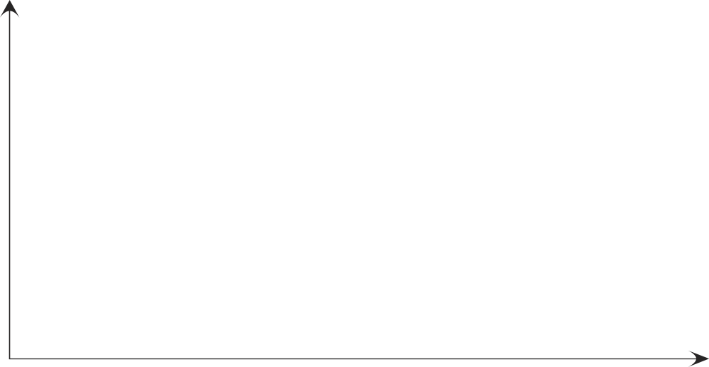
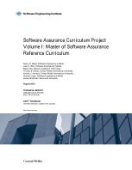
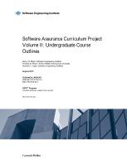
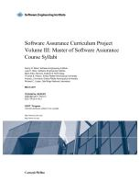
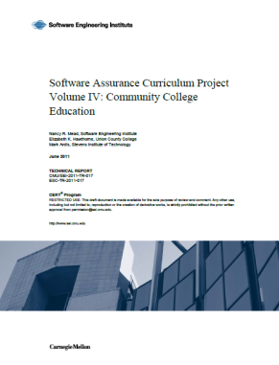


Software Assurance Curriculum Project
Goals: Develop software assurance curricula
Define transition strategies for implementation
Community Outreach
AMCIS
COMPSAC
SSTC
FISSEA
CISSE keynote
170+ Members of SwA Ed
Master of
Software Assurance
Reference
Curriculum
Community
College
Education
Undergraduate
Course
Outlines
MSwA
Syllabi
Integrated into course offerings
Carnegie Mellon University
Stevens Institute of Technology
US Air Force Academy
University of Detroit Mercy
University of Houston
Needs
MSwA course materials
  Nine SwA core courses
Curriculum Development
  MSwA course descriptions
  for other degree programs
  Undergraduate curriculum
  with specializations
  High school needs
August 2010
March 2011
Fall 2011
Professional Society Recognition
2009
2013
Notes:
Walk through this slide. I know that the captions on the reports may be hard to read, so I’ll read them off. All the reports are on our SwA Curriculum website. There is a link included in the resources for the site.

Slide 5
Purpose of SwA Competency Model
The Software Assurance (SwA) Competency Model was developed to support the following uses:
  Enable assessment of SwA capabilities of employee candidates
  Offer guidance for developing SwA courses for an organization
  Provide information about industrial competency needs and expectations for curricula development
  Provide guidance for SwA professional development and career planning
  Provide support for professional certification and licensing
Notes:
So the idea of the competency model was born. It was developed by the members of the software assurance curriculum team, and the primary author is Tom Hilburn, professor emeritus of software engineering at ERAU. The uses that the model is intended for are shown on the slide.

Slide 6
Sources
When developing the SwA Competency Model, research included consulting the following sources beyond the curriculum:
  Software Assurance Professional Competency Model (Department of Homeland Security, 2012)
  Information Technology Competency Model (Department of Labor, 2012)
  A Framework for PAB Competency Models (Professional Advisory Board and IEEE Computer Society, 2012)
  Balancing Software Engineering Education and Industrial Needs (Ana M. Moreno et al, 2012)
Notes:
The Homeland Security model has been released and is specific to DHS positions. There is a much higher level info tech competency model. IEEE CS has developed a framework for PAB competency models, which we are following and we hope to submit our competency model for IEEE approval. Another very good source is …Ana Moreno at Polytechnic University of Madrid.

Slide 7
Validation Method
As the model was being developed, it was validated by industry reviewers, who are mapping the model to typical positions/skills. This helped to identify gaps and inconsistencies. Among others, the validators included representatives from:
  (ISC)² Board of Directors
  Harris Corporation
  Symantec
Notes:
We initially validated the model with the entities listed above. Additional organizations would be welcome to validate the model against their existing positions. This can be done anonymously if you prefer.

Slide 8
Definition of Competency
In the SwA Competency Model, the term competency represents the set of knowledge, skills, and effectiveness needed to carry out the job activities associated with one or more roles in an employment position:
  Knowledge is what an individual knows and can describe (e.g., can name and define various classes of risks).
  Skills are what an individual can do and involves application of knowledge to carry out a task (e.g., can identify and classify the risks associated with a project).
  Effectiveness is concerned with the ability to apply knowledge and skills in a productive manner, characterized by attributes of behavior such as aptitude, initiative, enthusiasm, willingness, communication skills, team participation, and leadership.
Notes:
This is our definition of competency from the model. Knowledge, skills, and abilities (KSAs) are what you typically see in a curriculum BoK. This is a little different in that it discusses KS and effectiveness. Effectiveness is a bit subjective, but we all know it when we see it. Most competency models include Knowledge and skills. Some have activities instead of effectiveness. There is a bit of variation among the different models.

Slide 9
Levels of Competency
Levels of competency are used to distinguish between different levels of professional capability relative to knowledge, skills, and effectiveness. The five levels of SwA competency are characterized as follows:
  L1: Technician
  L2: Professional Entry Level
  L3: Practitioner
  L4: Senior Practitioner
  L5: Expert
Notes:
Our model has 5 levels of competency. If you look at other competency models you will see that the number of levels varies. Nevertheless, we have defined 5 levels of SwA competency and the KSEs associated with them.

Slide 10
L1: Technician
The following are characteristics of level 1.
  A technician possesses technical knowledge and skills, typically gained through a certificate or an associate degree program, or equivalent knowledge and experience.
  Personnel at this level of competency may be employed in a system operator, implementer, tester, or maintenance position with specific individual tasks assigned by someone at a higher level.
  Main areas of competency are System Operational Assurance, System Functional Assurance, and System Security Assurance.
  Major tasks are tools support, low-level implementation, testing, and maintenance.
Notes:
I’m going to walk through each of these and it will be pretty clear what the distinctions are and why we ended up with 5 levels in this particular case. These can be used not just by organizations, but by educators deciding what level to teach, and by individuals doing career planning, including people who are new to the field.

Slide 11
L2: Professional Entry Level
The following are characteristics of level 2.
  A professional entry level professional possesses application-based knowledge and skills and entry-level professional effectiveness, typically gained through a bachelor’s degree in computing or through equivalent professional experience.
  Personnel at this level of competence may perform all tasks of L1 as well as manage a small internal project, supervise and assign sub-tasks for L1 personnel, supervise and assess system operations, and implement commonly accepted assurance practices.
  Main areas of competency are System Functional Assurance, System Security Assurance, and Assurance Assessment.
  Major tasks are requirements fundamentals, component design, and implementation.

Slide 12
L3: Practitioner
The following are characteristics of level 3.
  A practitioner possesses a breadth and depth of knowledge, skills, and effectiveness beyond the L2 level and typically has two to five years of professional experience.
  Personnel at this level may perform all tasks of L2 personnel as well as set plans, tasks, and schedules for in-house projects; define and manage such projects and supervise teams on the enterprise level; report to management; assess the quality of systems; and implement and promote commonly accepted software assurance practices.
  Main areas of competency are Risk Management, Assurance Assessment, and Assurance Management.
  Major tasks are requirements analysis, architectural design, tradeoff analysis and risk assessment.

Slide 13
L4: Senior Practitioner
The following are characteristics of level 4.
  A senior practitioner possesses breadth and depth of knowledge, skills, and effectiveness and a variety of work experiences beyond the L3 level with five to ten years of professional experience and advanced professional development at the master’s level or with equivalent education/training.
  Personnel at this level may perform all tasks of L3 personnel as well as identify and explore best practices of software assurance for implementation, manage large projects, interact with external agencies, etc.
  Main areas of competency are Risk Management, Assurance Assessment, Assurance Management, and Assurance Across Life Cycles.
  Major tasks are assurance assessment, assurance management, and risk management across the life cycle.

Slide 14
L5: Expert
The following are characteristics of level 5.
  An expert possesses competency beyond the L4 level.
  He or she advances the field by developing, modifying, and creating methods, practices and principles at the organizational level or higher.
  An expert has peer/industry recognition.
  Typically, experts include a low percentage of an organization’s work force within the software assurance profession (e.g., 2 % or less).

Slide 15
Software Assurance Body of Knowledge (SwABoK)
Knowledge Area (KA) | KA Competency
AALC: Assurance Across Life Cycles (L3, L4, L5) | The ability to incorporate assurance technologies and methods into life-cycle processes and development models for new or evolutionary system development and for system or service acquisition
RM: Risk Management (L2, L3, L4, L5) | The ability to perform risk analysis and tradeoff assessment and to prioritize security measures
AA: Assurance Assessment (L1, L2, L3, L4) | The ability to analyze and validate the effectiveness of assurance operations and create auditable evidence of security measures
AM: Assurance Management (L3, L4, L5) | The ability to make a business case for software assurance, lead assurance efforts, understand standards, comply with regulations, plan for business continuity, and keep current in security technologies
SSA: System Security Assurance (L1, L2, L3, L4) | The ability to incorporate effective security technologies and methods into new and existing systems
SFA: System Functionality Assurance (L1, L2, L3) | The ability to verify new and existing software system functionality for conformance to requirements and to help reveal malicious content
SOA: System Operational Assurance (L1, L2, L3) | The ability to monitor and assess system operational security and respond to new threats
Notes:
The BoK that we are using is from the MSwA reference curriculum, which was mentioned in the timeline, and is posted on our website. For each knowledge area, we indicate the competency levels associated with it.

Slide 16
Competency Attributes of Effectiveness ¹
Aptitude: The ability do a certain software assurance activity at a certain level of competence. Aptitude is not the same as knowledge or skill but rather indicates the ability to apply knowledge in a skillful way. (L2-L5)
Initiative: The ability to start and follow through on a software assurance work activity with enthusiasm and determination. (L1-L5)
Enthusiasm: Being interested in and excited about performing a software assurance work activity. (L1-L5)
Willingness: undertaking a work activity when asked, even if it is an activity the individual is not enthusiastic about performing. (L1-L5)
Notes:
The effectiveness elements are not part of the BoK, but were developed specifically for the competency model. I will say that some universities that are teaching software engineering to existing and future practitioners do consider some of these attributes, especially on team projects.

Slide 17
Competency Attributes of Effectiveness ²
Communication: expressing thoughts and ideas in both oral and written forms in a clear and concise manner while interacting with team members, managers, project stakeholders, and others. (L2-L5)
Teamwork: Working professionally and willingly with other team members while collaborating on work activities. (L1-L5)
Leadership: Effectively communicating a vision, strategy, or technique that is accepted and shared by team members, managers, project stakeholders, and others. (L3-L5)
Notes:
Question: Would a software assurance competency model help you in staffing projects? Vast majority voted yes

Slide 18
SwA Competency Designations ²
Assurance Across Life Cycles
Risk Management
Assurance Management
System Security Assurance
System Functionality Assurance
System Operational Assurance
Assurance Assessment
Competency Attributes of Effectiveness
  Risk Management Concepts
  Risk Management Process
  Software Assurance Risk Management

Slide 19
Example from the SwA Competency Model
KA | Unit | Competency Activities
Risk Management | Risk Management Concepts | L1: Understand the basic elements of risk management, including threat modeling. L2: Explain how risk analysis is performed. L3: Determine the models, process, and metrics to be used in risk management for small internal projects. L4: Develop the models, processes, and metrics to be used in risk management of projects of any size. L5: Analyze the effectiveness of the use and application of risk management concepts across an organization.
Notes:
This example shows the risk management knowledge area, one of the units, and the competency activities associated with it. This is just one element of the competency table that appears in the draft report.
Question: If you are an educator/trainer, does a software assurance competency model help you with curriculum or course content decisions? (Yes/no)

Slide 20
Uses of the model
We envision the following uses:
Since it is a general model, industry and government organizations can instantiate the model for their own use.
Faculty can use the model in conjunction with course development and outcomes.
Industry managers can use the model for assessing SwA competencies and also for recruiting and building teams.
SwA professionals can use the model for career planning.
New graduates can use the model to map their SwA skills to job position descriptions and interviews, as well as for planning their next career growth steps.

Slide 21
Summary and Plans
To summarize the competency model work activities:
The model builds on the prior software assurance curriculum work, and on other competency models.
The model has been published as an SEI report and presented at DHS meetings, as a BrightTalk Webinar, and here.
An additional short paper for IEEE Security and Privacy is planned.

Slide 22
Additional Resources
Hilburn, Thomas; Ardis, Mark; Johnson, Glenn; Kornecki, Andrew; & Mead, Nancy. Software Assurance Competency Model (CMU/SEI-2013-TN-004). Software Engineering Institute, Carnegie Mellon University, 2013. http://www.sei.cmu.edu/library/abstracts/reports/13tn004.cfm
SwA Curriculum Website: http://www.cert.org/mswa/

Slide 23
Questions?

Slide 24
Copyright 2013 Carnegie Mellon University.
This material is based upon work supported by the Department of Defense under Contract No. FA8721-05-C-0003 with Carnegie Mellon University for the operation of the Software Engineering Institute, a federally funded research and development center.
Any opinions, findings and conclusions or recommendations expressed in this material are those of the author(s) and do not necessarily reflect the views of the United States Department of Defense.
NO WARRANTY
THIS CARNEGIE MELLON UNIVERSITY AND SOFTWARE ENGINEERING INSTITUTE MATERIAL IS FURNISHED ON AN “AS-IS” BASIS. CARNEGIE MELLON UNIVERSITY MAKES NO WARRANTIES OF ANY KIND, EITHER EXPRESSED OR IMPLIED, AS TO ANY MATTER INCLUDING, BUT NOT LIMITED TO, WARRANTY OF FITNESS FOR PURPOSE OR MERCHANTABILITY, EXCLUSIVITY, OR RESULTS OBTAINED FROM USE OF THE MATERIAL. CARNEGIE MELLON UNIVERSITY DOES NOT MAKE ANY WARRANTY OF ANY KIND WITH RESPECT TO FREEDOM FROM PATENT, TRADEMARK, OR COPYRIGHT INFRINGEMENT.
This material has been approved for public release and unlimited distribution except as restricted below.
Internal use:* Permission to reproduce this material and to prepare derivative works from this material for internal use is granted, provided the copyright and “No Warranty” statements are included with all reproductions and derivative works.
External use:* This material may be reproduced in its entirety, without modification, and freely distributed in written or electronic form without requesting formal permission. Permission is required for any other external and/or commercial use. Requests for permission should be directed to the Software Engineering Institute at permission@sei.cmu.edu.
*These restrictions do not apply to U.S. government entities.

Slide 25
SwA Competency Designations ¹
Assurance Across Life Cycles
Risk Management
Assurance Management
System Security Assurance
System Functionality Assurance
System Operational Assurance
Assurance Assessment
Competency Attributes of Effectiveness
  Software Life-Cycle Processes
  Software Assurance Processes and Practices
Notes:
The next set of slides shows each of the 7 BoK areas, along with effectiveness, and the knowledge units that are associated with it. If we are pressed for time, I will gloss over some of these and you can take a look at them later on.

Slide 26
SwA Competency Designations ³
Assurance Across Life Cycles
Risk Management
Assurance Management
System Security Assurance
System Functionality Assurance
System Operational Assurance
Assurance Assessment
Competency Attributes of Effectiveness
  Assurance Assessment Concepts
  Measurement for Assessing Assurance

Slide 27
SwA Competency Designations ⁴
Assurance Across Life Cycles
Risk Management
Assurance Management
System Security Assurance
System Functionality Assurance
System Operational Assurance
Assurance Assessment
Competency Attributes of Effectiveness
  Making the Business Case for Assurance
  Managing Assurance
  Compliance Considerations for Assurance

Slide 28
SwA Competency Designations ⁶
Assurance Across Life Cycles
Risk Management
Assurance Management
System Security Assurance
System Functionality Assurance
System Operational Assurance
Assurance Assessment
Competency Attributes of Effectiveness
  For Newly Developed and Acquired Software for Diverse Applications
  For Diverse Operational (Existing) Systems
  Ethics and Integrity in Creation, Acquisition, and Operation of Software Systems

Slide 29
SwA Competency Designations ⁶
Assurance Across Life Cycles
Risk Management
Assurance Management
System Security Assurance
System Functionality Assurance
System Operational Assurance
Assurance Assessment
Competency Attributes of Effectiveness
  Assurance Technology
  Assured Software Development
  Assured Software Analytics
  Assurance in Acquisition

Slide 30
SwA Competency Designations ⁷
Assurance Across Life Cycles
Risk Management
Assurance Management
System Security Assurance
System Functionality Assurance
System Operational Assurance
Assurance Assessment
Competency Attributes of Effectiveness
  Operational Procedures
  Operational Monitoring
  System Control

Slide 31
SwA Competency Designations ⁸
Assurance Across Life Cycles
Risk Management
Assurance Management
System Security Assurance
System Functionality Assurance
System Operational Assurance
Assurance Assessment
Competency Attributes of Effectiveness
  Aptitude
  Initiative
  Enthusiasm
  Willingness
  Communication
  Teamwork
  Leadership

